Slide 1
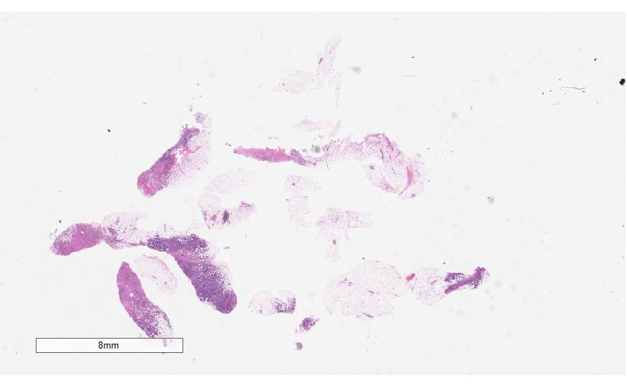
Digital Pathology Image Interpretation
Presented By:
Vahid Khalkhali
Neural Engineering Data Consortium,
Temple University

Slide 2
Outline
Digital Pathology
Process Pipeline
Our Current State
Technical Challenges
Plans
Q & A

Slide 3
Digital Pathology
Pathology is a branch of medical science focused on the cause, origin, and nature, of disease
A typical pathology laboratory workflow involves the preparation of a very thin tissue specimen mounted on a glass slide.
Digital Pathology refers to the process of digitizing an analog image so that images can be retrieved, manipulated, and evaluated by computers.
There are currently two dominant vendors in the commercial marketplace. Our group use Leica Biosystems Aperio.
The slide files are 3 or 4 flat 2d images.

Slide 4
Process Pipeline
Computing Infrastructure
Image Digitization
Data Organization
Data Anonymization
Data Annotation
Neuronix: high-performance computing (HPC) cluster
Aperio AT2 high volume scanner (JPEG2000)
Aperio eSM Web Server with naming conventions
Deidentification and transfer to Neuronix
Freehand annotation, XML labels

Slide 5
Our Current State
Currently, our group has done all the fundamental steps. Organizing the overall process is needed.
Computing Infrastructure
Image Digitization
Data Organization
Data Anonymization
Data Annotation
Neuronix: high-performance computing (HPC) cluster
Aperio AT2 high volume scanner (JPEG2000)
Aperio eSM Web Server with naming conventions
Deidentification and transfer to Neuronix
Freehand annotation, XML labels

Slide 6
Technical Challenges
Anonymization procedure and tools need to be documented.
It seems that the group has not decided about the labels’ container.
The large size of images in the lowest level of slides makes most computations infeasible.
If the number of images increases significantly, the storage space can be a challenge.
Automated cancer recognition cannot be built on low number of annotated data.
Speeding up the speed of annotation and training more annotators are necessary.

Slide 7
Plan
Near term:
Finish the deidentification process with documents
Decide about the labels’ container and make necessary conversions
Decide about images data manipulation
Long term:
Generating 100,000 images.
Speed up annotation process
Making automated cancer recognition system

Slide 8
Q & A
Thank You!

Slide 9
References
Shawki, N., Shadhin, M. G. M., Elseify, T., Jakielaszek, L., Farkas, T., Persidsky, Y., … Picone, J. (2020). The Temple University Digital Pathology Corpus. In I. Obeid, I. Selesnick, & J. Picone (Eds.), Signal Processing in Medicine and Biology: Emerging Trends in Research and Applications (1st ed., pp. 67–104). New York City, New York, USA: Springer. https://doi.org/10.1007/978-3-030-36844-9
Aperio Digital Pathology Solutions, Accessed on: May. 14, 2020, [Online]. Available: https://www2.leicabiosystems.com/

