Slide 1
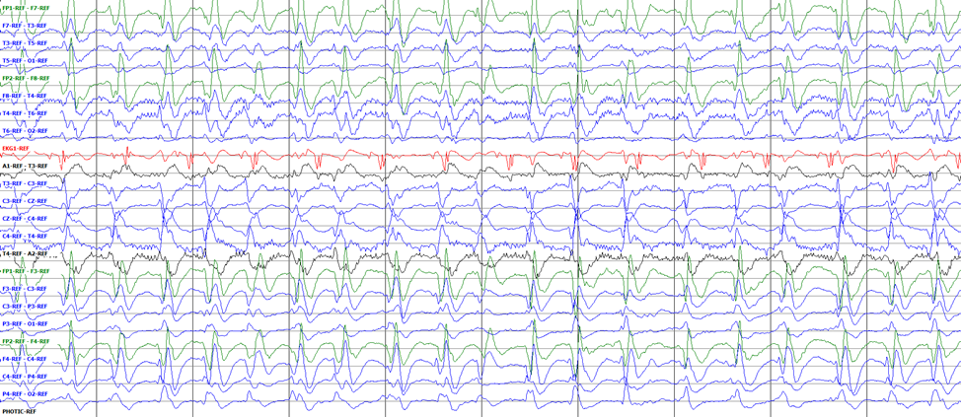
Release Plans for TUEG and TUSZ
Presented By:
Saf Rahman
Neural Engineering Data Consortium,
Temple University

Slide 2
Overview
Data Collection at the Hospital
Triaging and annotation of data
Annotation file processing
Latest releases
Obstacles
Future Plans
Saf Rahman
May 29, 2020

Slide 3
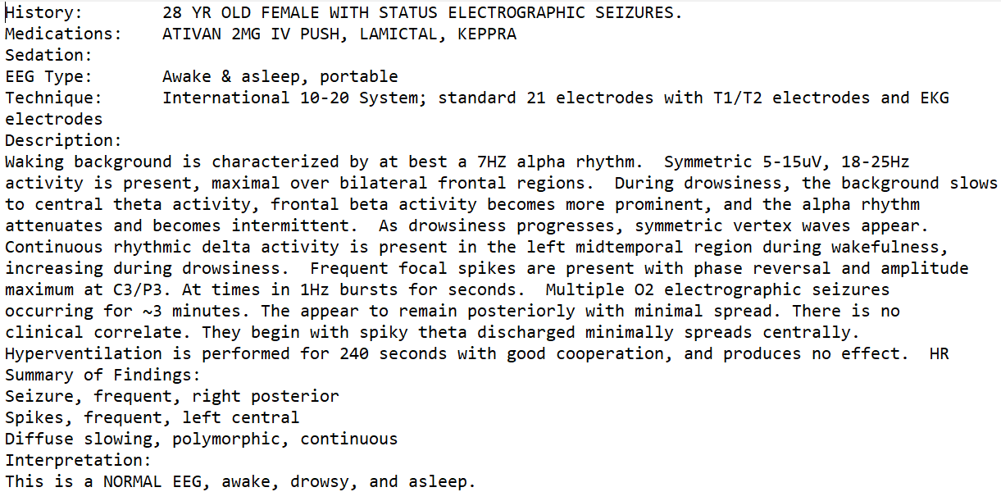
Data Collection
The EDF files are originally derived from Temple University Hospital
The hospital team is tasked with deidentifying all EEG files as well as their associated reports
Once the files are deidentified and compliant with HIPAA regulations they are sent over to the annotation team at the main campus
Saf Rahman
May 29, 2020

Slide 4
TUH EEG Corpus
The most current and largest release of our open source EEG data. This corpus contains EEG sessions collected by TUH from 2002 to 2016
Alongside the added EEG sessions are the medical histories for each patient
Saf Rahman
May 29, 2020

Slide 5
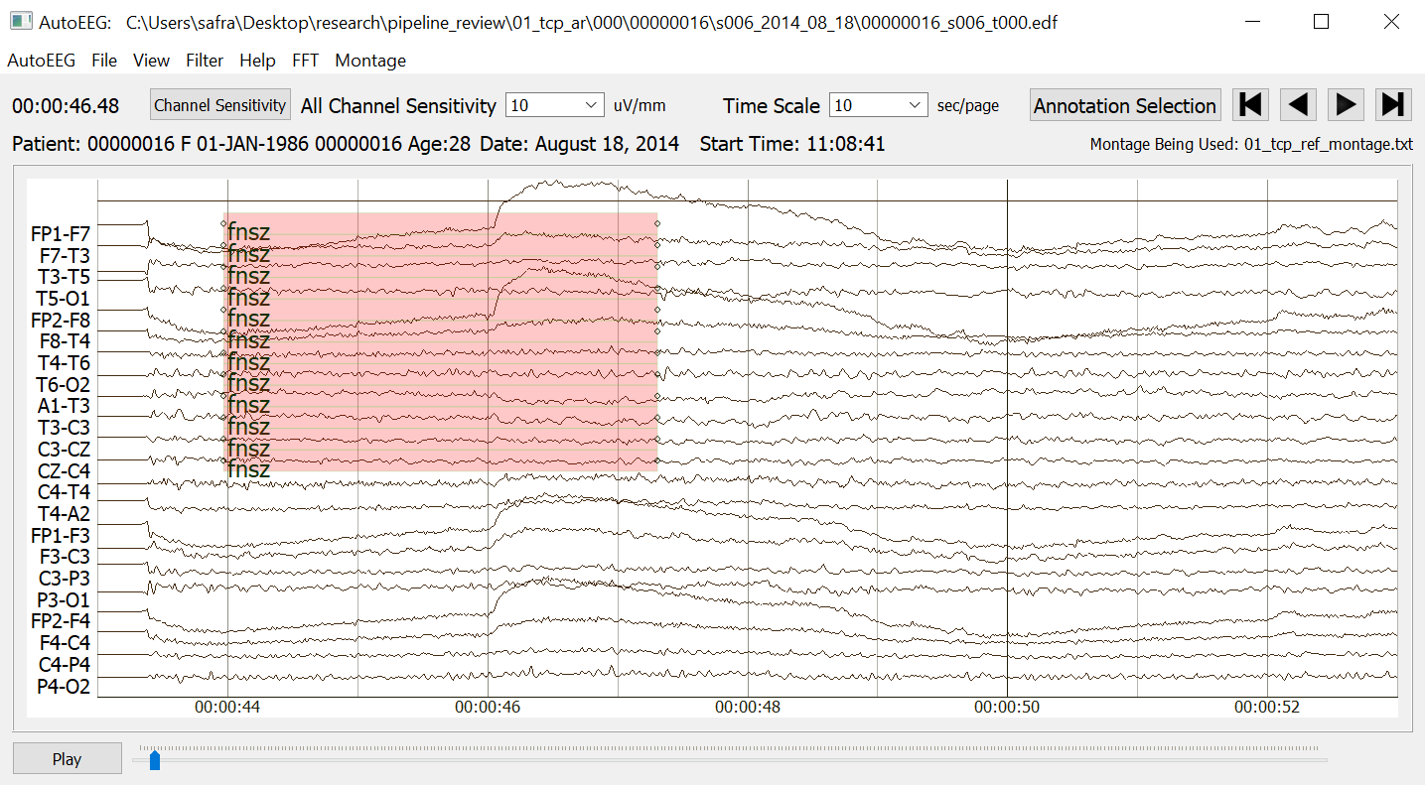
Development of TUSZ
Files from the TUH EEG corpus are triaged in order to obtain files that have a high probability of including seizures
All the seizures in the subset are annotated by the annotation team, rec files are generated
The .rec files are used to generate .tse and .lbl files which are what we officially release
Saf Rahman
May 29, 2020

Slide 6
Latest releases
TUEG v1.2.0
TUSZ v1.5.2
Updated annotations of the train set from v1.5.0
v1.5.1 was the updated eval and dev sets
 | No. of patients | No. of Sessions | No. of Files | No. of Seizures
Dev | 50 | 238 | 1013 | 685
Train | 592 | 1185 | 4597 | 2370
Saf Rahman
May 29, 2020

Slide 7
Obstacles
There is a delay in getting deidentified data from the hospital
Everyone working there is busy, so it is difficult getting them to give priority to our data
The annotation team is not going through the data fast enough
The process of hiring and getting new annotators up to standards
Quality control of the data
Side tasks that come up such as the artifact annotation task (TUAR)
Saf Rahman
May 29, 2020

Slide 8
Future Plans
TUEG v2.0
A cumulative release of all sessions and corresponding reports to date
TUSZ v1.6.0
Third_pass_set + 2016 data
TUSZ v1.7.0
no_reports data - 13,725 files but will be triaged using the current best system
Saf Rahman
May 29, 2020

Slide 9
Questions
Saf Rahman
May 29, 2020

