Slide 1
Multiphase Seizure Detection Model
Presented By:
Vinit Shah
Neural Engineering Data Consortium,
Temple University

Slide 2
Typical Seizure Morphology
Electroencephalography (EEG) is a commonly used means to diagnose brain-related diseases including epilepsy. EEG signals contain information in temporal and spatial domain.
EEG signals are categorized in specific frequency bands called “rhythms”.
Seizures are identified by observing evolution of abnormal epileptiform events such as Spike and wave discharges/complexes, generalized polyspikes, etc.
Typical seizures show high frequency and low amplitude signals which evolve by showing progressively slowed down (lower) frequency with high amplitude signals.
Such epileptiform events observed at at least 3 Hz frequency lasting for 10 seconds is considered as a seizure event (Hard decision).
Rhythm | Frequency (Hz) | Amp. Range (μv) | Activity
Delta | 0-4 | 20-200 | Deep sleep
Theta | 4-7 | 20-100 | Creativity, intuition
Alpha | 8-13 | 20-60 | Relaxation
Beta | 13-30 | 2-20 | Memory
Gamma | 30-100 | 20-70 | Cognition, learning

Slide 3
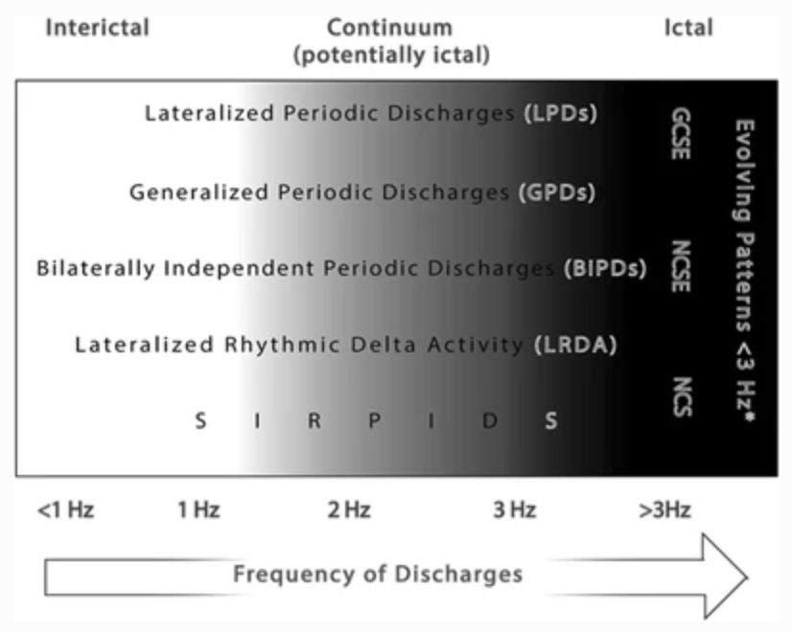
Why Annotating Seizures is hard?
The seizure events can be categoried into two forms:
Metamorphic
Isomorphic
Metamorphic events show clear phases of evolution.
Isomorphic events evolves very slowly and does not show any clear onset and/or offset point.
Periodic epileptiform discharges evolving at lower frequencies makes it difficult to confirm a seizure event.
“Generalized spike and wave patterns slower than 3/s; and evolving discharges that remain slower than or equal to 4/s does not imply that these patterns are not ictal, but simply that they may or may not be” (ACNS guidelines)
Artifacts, burst attenuation/suppression and post-ictal slowing makes interpretation process further difficult. Last but not least, lower interrater agreement (IRA) among experts.

Slide 4
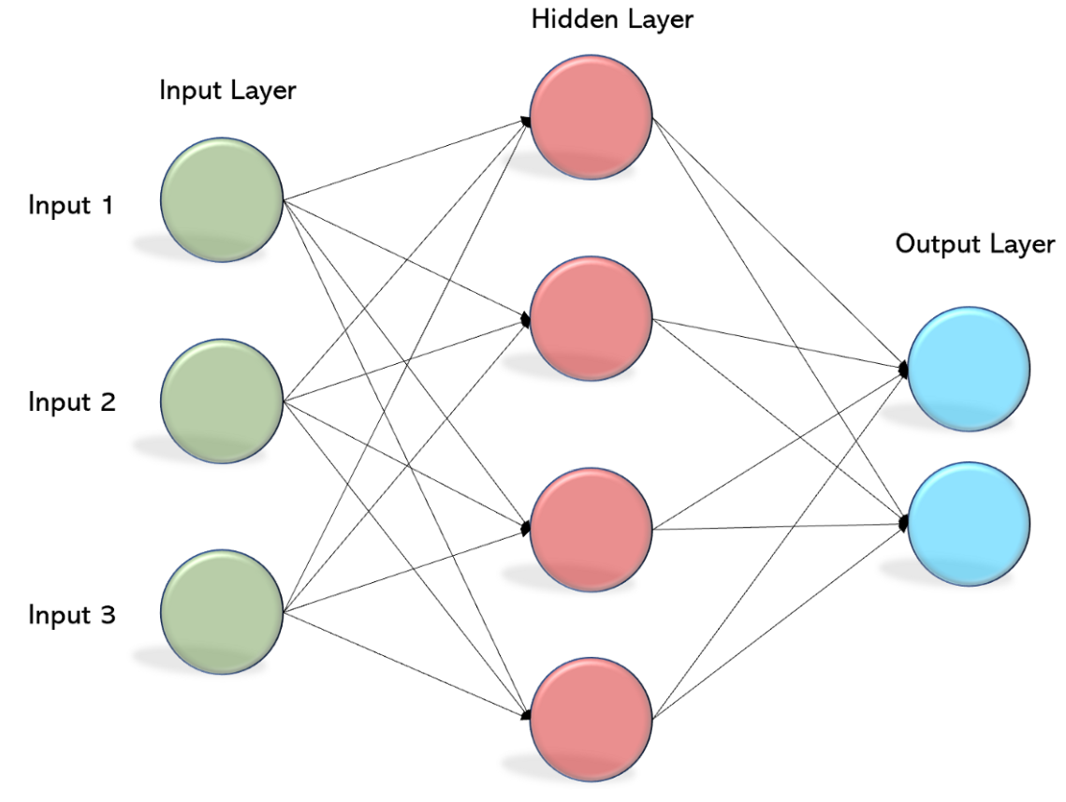
Multilayer Perceptron
Multilayer Perceptron, also known as fully connected network and dense network, are the building blocks of any neural network architecture.
All the neurons of each layer are connected with every other neuron of their adjacent layers.
$$y =Wx+b$$
Where W and b are the parameters; and x & y are the input and output vectors/tensors respectively.
Each layer is encapsulated by a nonlinear function known as activation function.
$MLP\left(x,𝓦\right)= f\left(x,𝓦\right) =f^{\left(L−1\right)}$ $\left(… f^{\left(0\right)} \left(x, 𝓦^{\left(0\right)}\right)… , 𝓦^{\left(L−1\right)} \right)$

Slide 5
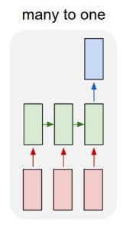
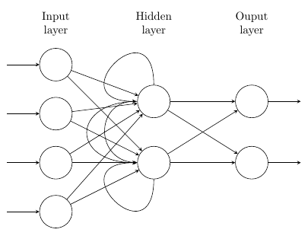
Recurrent Neural Networks
Vanilla recurrent neural networks are the building blocks which can efficiently learn sequential information presented in input data.
There are various ways to use these networks to handle variable length input/output sequences (e.g. many to many, many to one)
For EEG seizure detection, we use RNNs as a many to one model where multiple time-steps of an EEG signal is passed to the model and binary decision is made at the output layer.
Unlike other variants of neural networks, RNNs have ability influence its adjacent neurons.

Slide 6
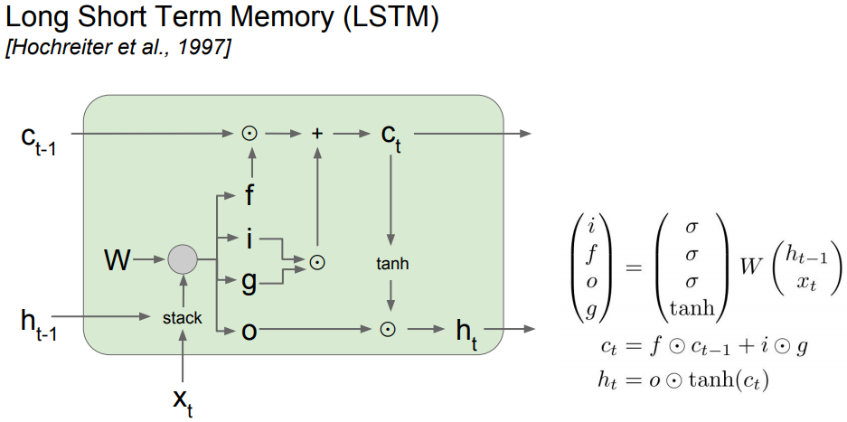
Long Short-term Memory Networks
RNNs suffer from vanishing or exploding gradient problems during backpropagation because gradients gets multiplied by identical weight matrices of the neurons.
Long short-term memory networks are designed to better handle gradient flow properties in a way that the weight matrices are able modified by the additional intermediate gates called input, ouput, forget gates.

Slide 7
Phase-1 model (Channel based LSTM network)
Phase 1 of the model uses an LSTM network specific to learn the epileptiform activities associated with the seizure events.
We use a 3-layer LSTM network with size (256, 64, 16).
Input layer includes a 7 second window (70 frames with LFCC feature vectors) with context size of 20 frames.
Training is performed in 3 stages:
Exploration of error space (high learning rates)
Stagnate with back-off (pleatued cross validation and training loss difference)
Annealing stage (gradual reduction in learning rate)

Slide 8
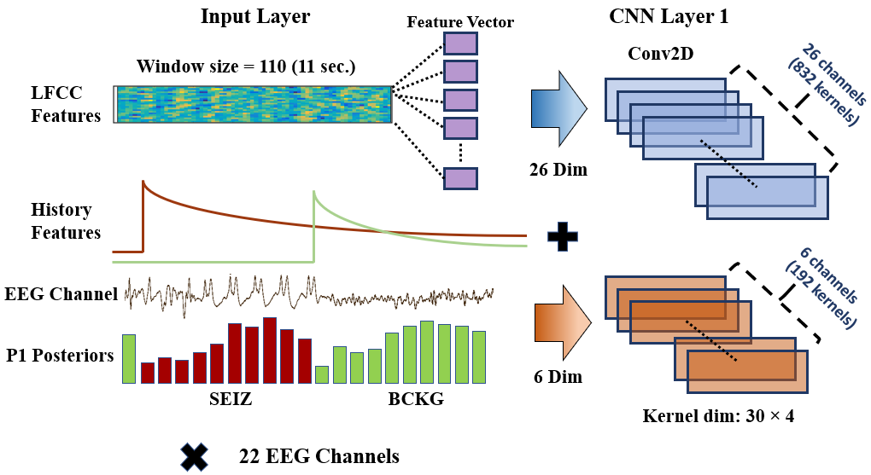
Feature augmentation
Posteriors from the P1 model are used as additional features for the following model/s
The onset and offset marks detected by the first model is used to weight the distance from the input samples.
$$event_dist=ø^{−n}+ eps$$
Where n is the time-stamp from the mark and $ø$ is a constant optimized for events.

Slide 9
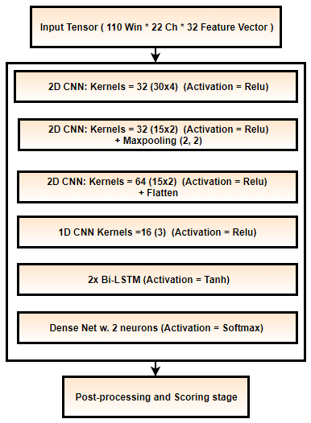
Phase 2 model (CNN + LSTM hybrid model)
During the phase 2 of the model, we learn temporal and spatial information using convolutional neural networks (CNNs) followed by LSTM networks.
This phase is designed to mimic human interpretation process where 11 seconds of context is observed, and first CNN layer observes 3 seconds of data (lower threshold for seizures).
CNN channels are assigned to learn each feature dimension independently.
192 out of 1024 total kernels are assigned to learn only posteriors and onset/offset features derived from the marks.
Finally, two small LSTM networks followed by a dense layer is used to classify the seizure event.

Slide 10
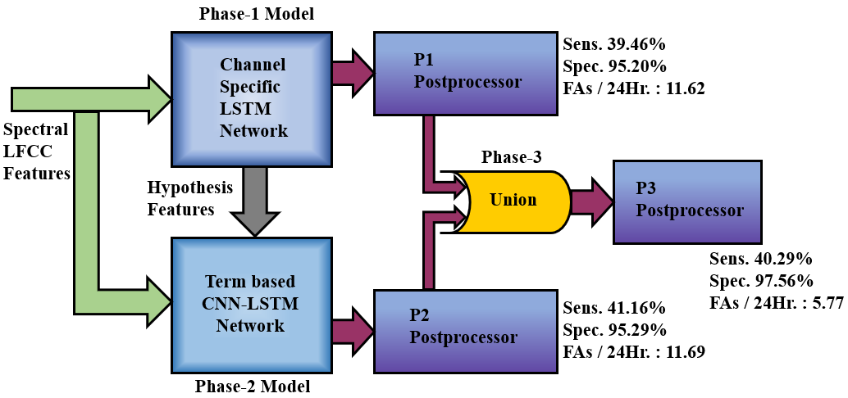
Results
Each phase of the model is postprocessed by heuristic postprocessing approaches such as setting thresholds for duration, probability of the event, etc.
The multiphase model performs at 40.29% sensitivity with 5.77 FAs/24 hours on Devtest set.
Metric | Measure | CNN/LSTM | Ch. LSTM P1 | CNN/LSTM P2 | MultiPhase P3
OVLP | Sensitivity | 30.83% | 39.46% | 41.16% | 40.29%
 | Specificity | 97.10% | 95.20% | 95.29% | 97.56%
 | FAs/24 hrs | 6.74 | 11.62 | 11.69 | 5.77
TAES | Sensitivity | 11.33% | 32.57% | 32.87% | 32.59%
 | Specificity | 95.58% | 85.48% | 89.28% | 90.72%
 | FAs/24 hrs | 7.62 | 27.44 | 20.85 | 17.03

Slide 11
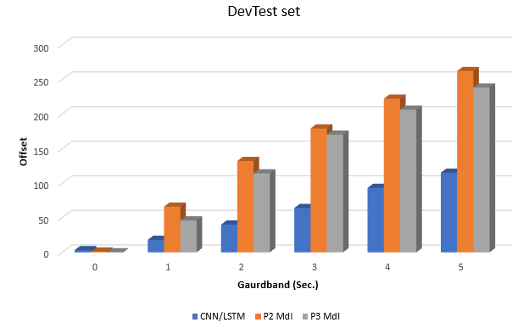
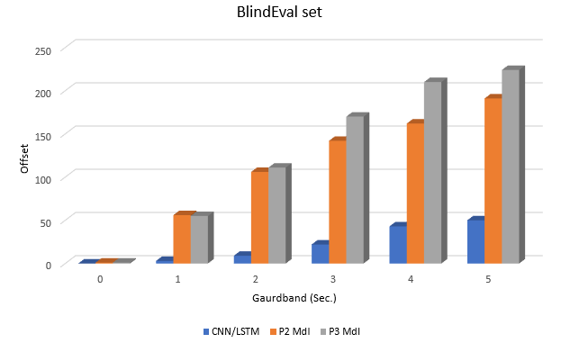
Convolutional Neural Network + LSTMs
Performance of model segmentation was evaluated around seizure segment boundaries with different guardbands.
More than 100 segment boundaries are detected within the margin of 2 seconds of the seizure event by the P2 and P3 model.
On the other hand, previous state-of-the-art CNN-LSTM model fails to detect majority of the segment boundaries within the acceptable ranges of gaurdband.

Slide 12
Thank You

