Slide 1
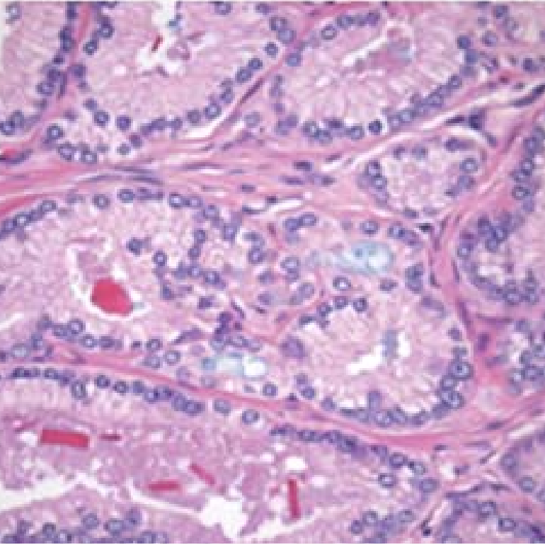
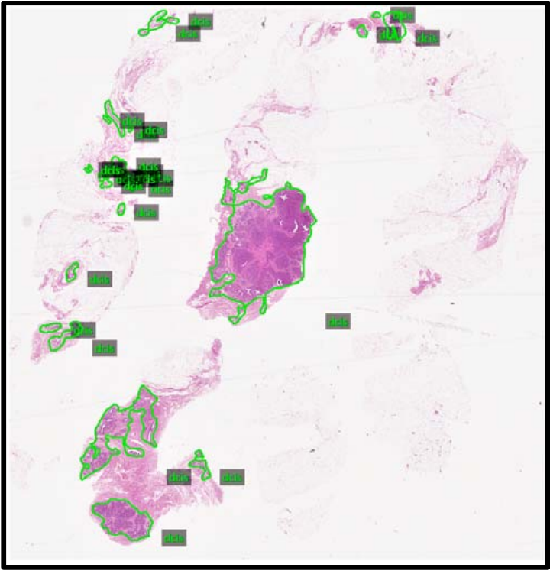
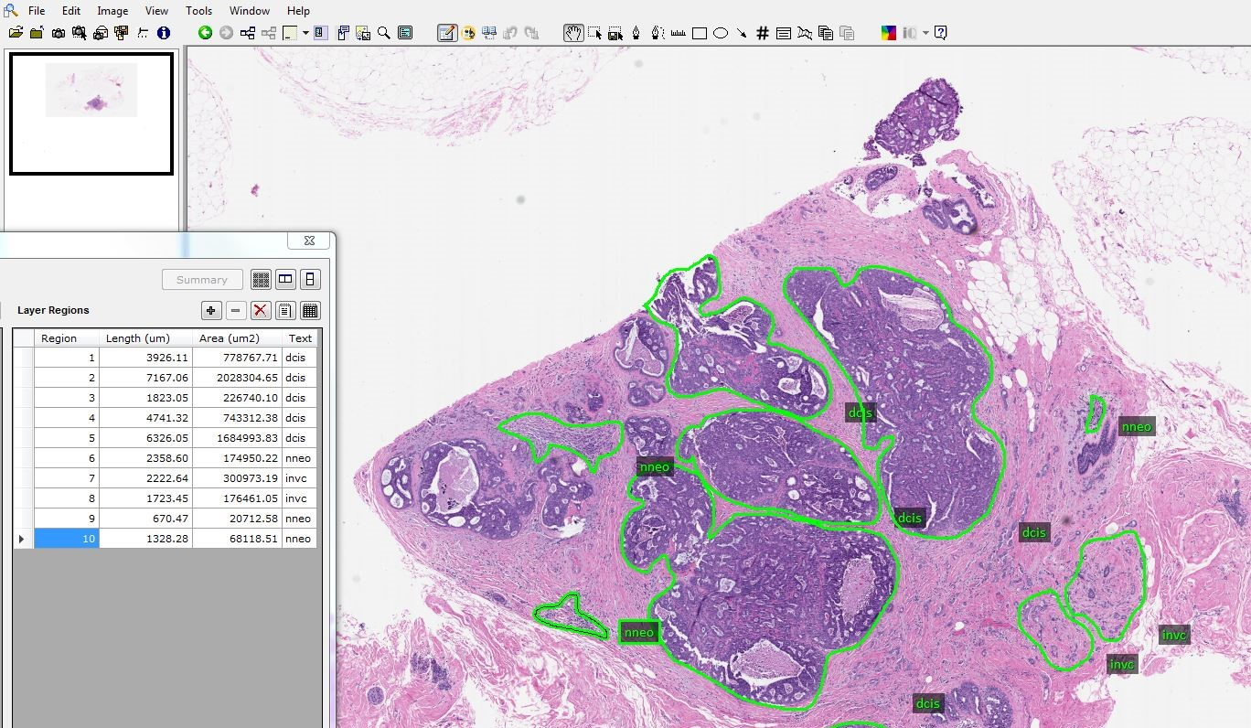
Digital Pathology (DPATH) Breast Tumor Corpus
Presented by Julien Simons
Neural Engineering Data Consortium
Temple University

Slide 2
DPATH Summary
The ability to scan slides into digital images and place them on a secure HIPPA network accessible to pathologists promotes remote accessibility and collaboration on patient cases.
The physical storage required to manage such a large archive electronically has been relatively affordable while enabling simple implementation within our computing architecture.
Our primary goal in this three-year project is to scan and annotate 1M slides, where each image will have an associated clinical report.
This corpus will enable the development of state-of-the art machine learning systems, which require vast amounts of training data, for pathology applications such as cancer identification.
This project will also enable the development of software systems to assist diagnosis and accelerate the diagnostic process, thereby easing pathologist workloads. This is important since the industry expects there will be a severe shortage of pathologists over the next 20 years.
Digital pathology is also enhancing educational practice by providing access to a large, open source pathology corpus that can be easily searched.
More information can be found at: https://www.isip.piconepress.com/projects/nsf_dpath/

Slide 3
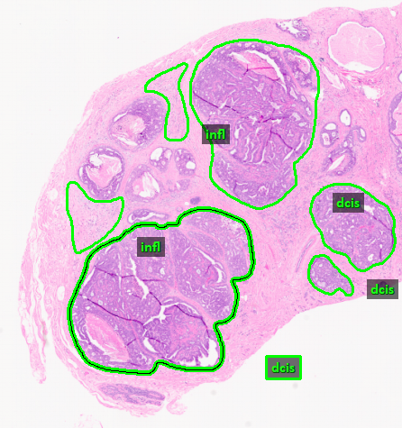
Tumor Annotations
We had previously annotated five features but have recently increased that number to nine, accommodating our increased familiarity of features.
Under the mentorship of Dr. Jhala, Director of Anatomic Pathology and Cytology at Temple University Hospital, our team of student annotators are building the training set for the machine learning algorithms.
Currently have over 850 XML annotations in our pilot breast tumor corpus.

Slide 4
Tumor Annotations
Cancerous
Ductal carcinoma in situ (DCIS): dcis
Invasive ductal carcinoma (IDC): indc
Carcinogenic Signs
Non-neoplastic feature: nneo
Inflammation: infl
Suspected carcinogen: susp
Non-Cancerous
Normal cells: norm
Background (stroma): bckg
Artifact (e.g. grease stain, stitches): artf
Indistinguishable tissue: null

Slide 5
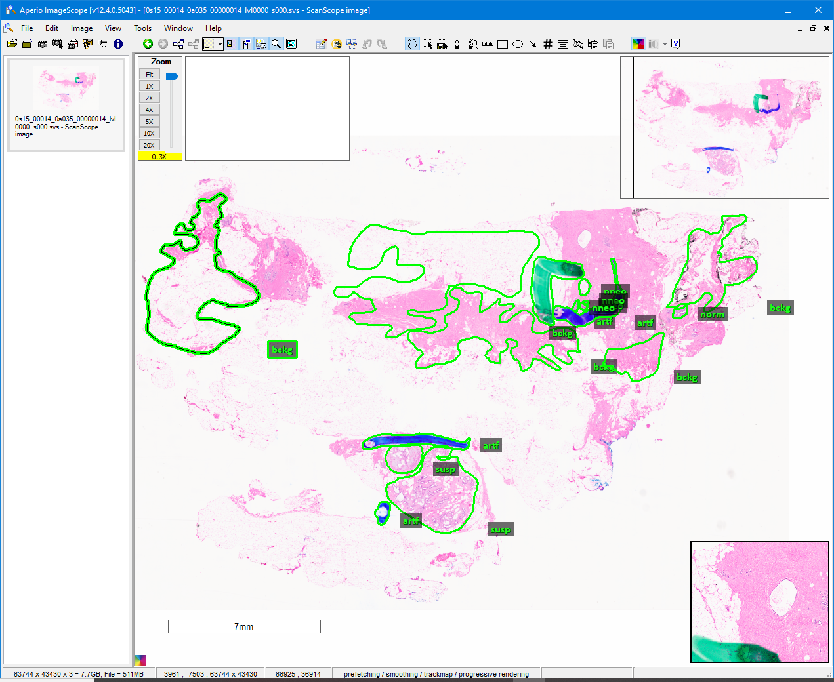
Annotation Example

Slide 6
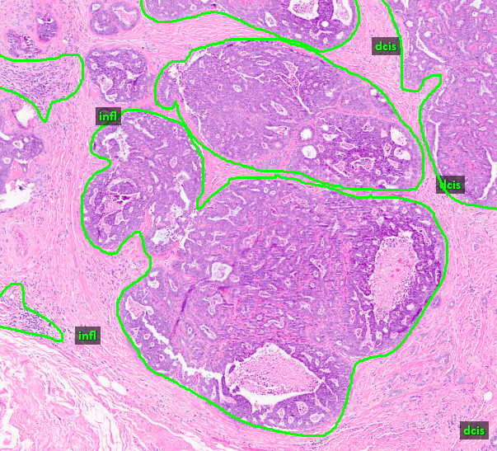
Cubiform or solid type.
The DCIS Label
Written as “dcis”
Low or grade I; moderate or grade II; and high or grade III.

Slide 7
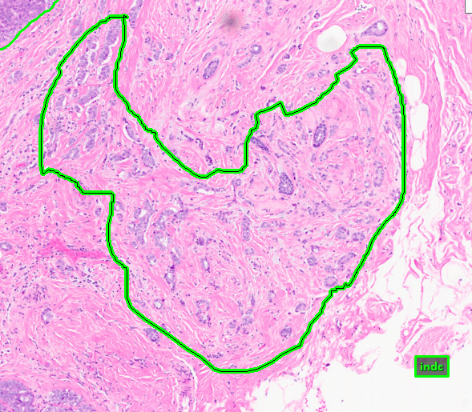
Free-form lobules without a container.
The IDC Label
Written as “indc”

Slide 8
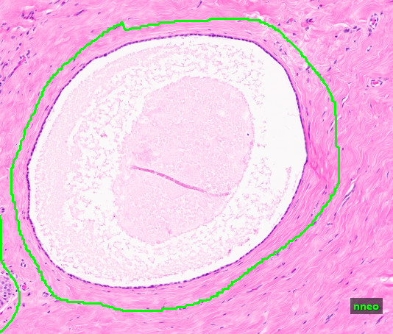
Occur when the lumen expands substantially.
Fibrocystic features.
The Non-Neoplastic Label: Fibrosis
Written as “nneo”

Slide 9
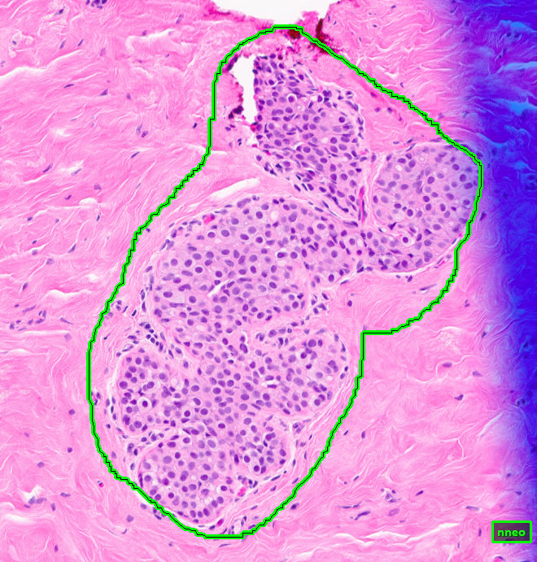
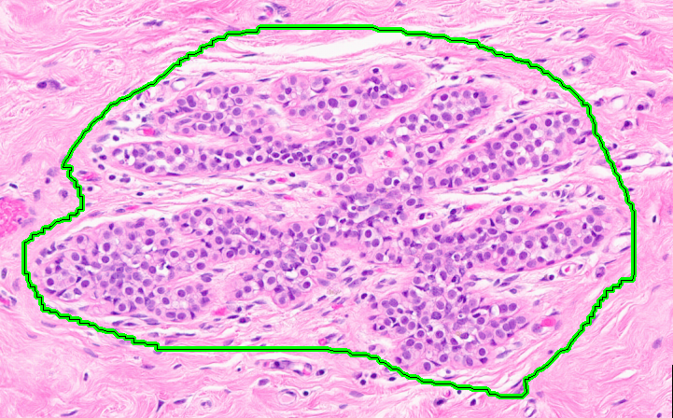
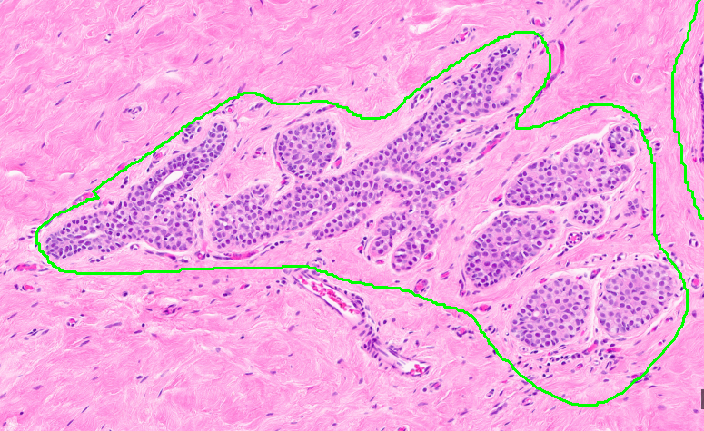
Occurs when the cells take up the lumen (the center white space of a cell).
The Non-Neoplastic Label: Hyperplasia
Written as “nneo”
Hyperplastic feature.

Slide 10
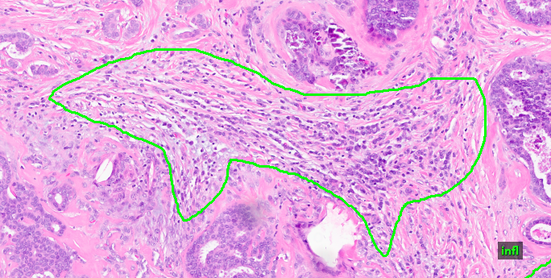
Multitude of small ball-like cells.
The Inflammation Label
Written as “infl”
Moves toward and latches on unwanted or unknown tissue.

Slide 11
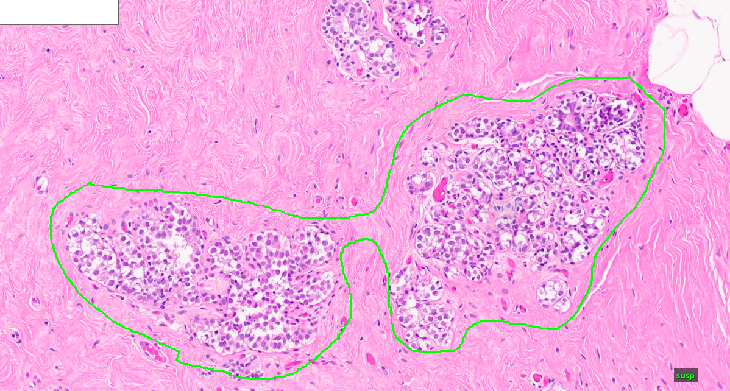
Suspected as DCIS, IDC, non-neoplastic, or other harmful tissue.
The Suspect Label
Written as “susp”

Slide 12
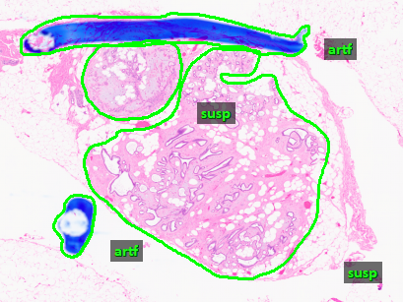
The Suspect Label (cont.)

Slide 13
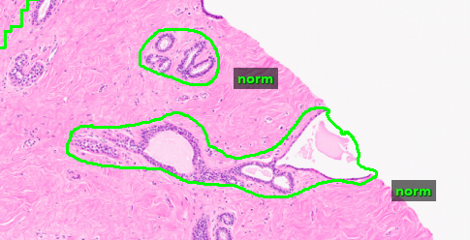
The Normal Label
Written as “norm”

Slide 14
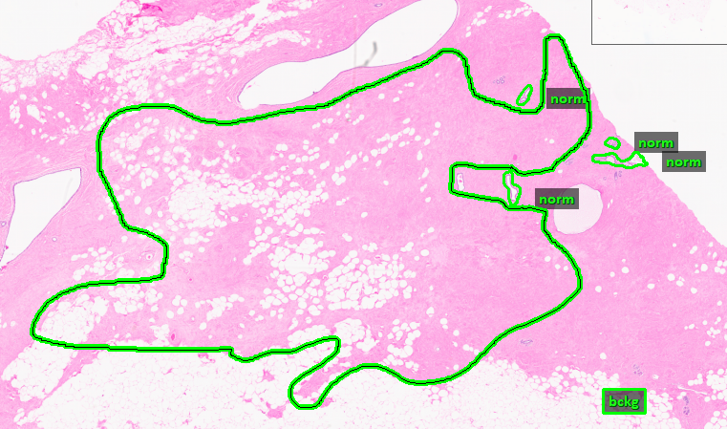
Represents normal “pink” tissue (stroma).
The Background Label
Written as “bckg”

Slide 15
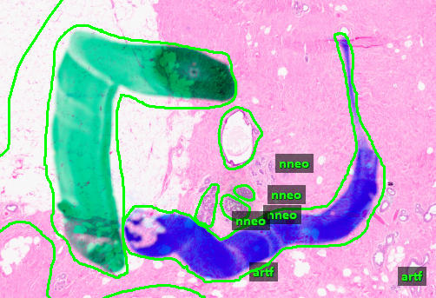
Grease pen marks, stiches, or unfocused scratches on the slide.
The Artifact Label
Written as “artf”

Slide 16
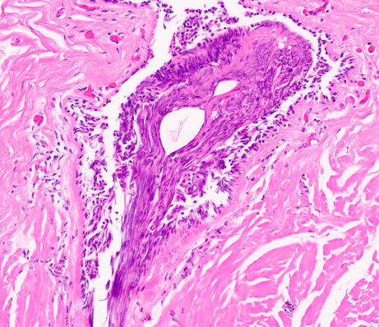
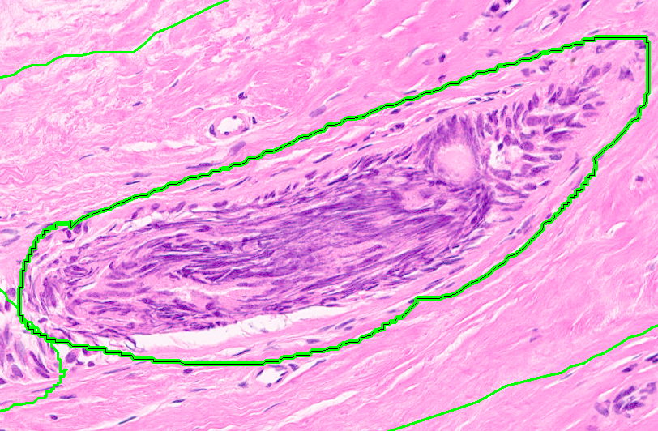
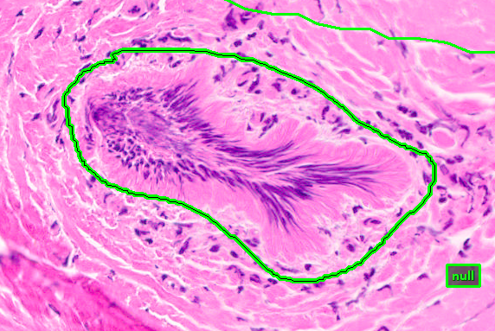
Elongated with a wave or stream-like pattern moving in a given direction, as if it were wiped.
The Null Label
Written as “null”
Caused as a result of resampling a specific region and/or from poorly cut tissue.

Slide 17
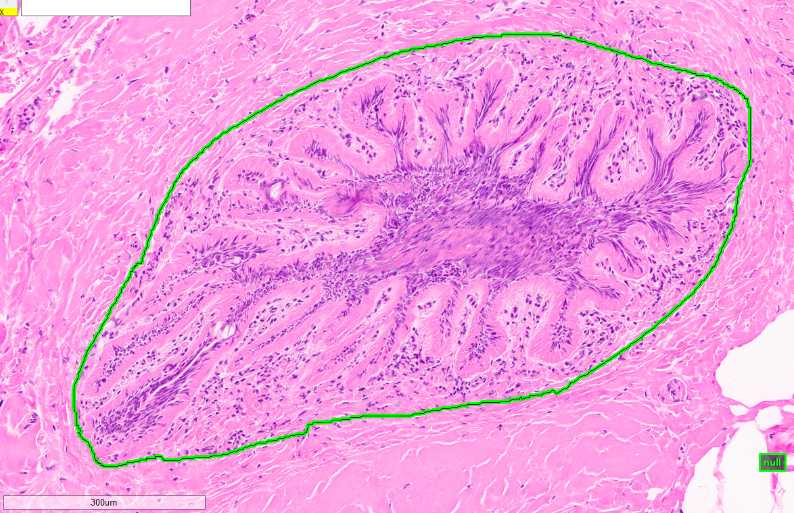
The Null Label (cont.)

