Slide 1
Seizures
Background

Slide 2
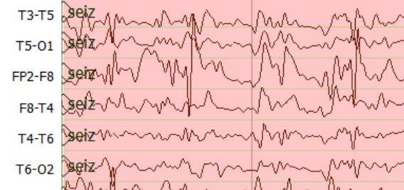
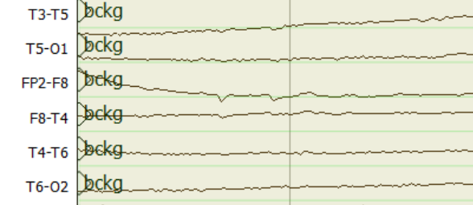
Output
Sequence Window of length M
Sample #: 1
Sample #: M/2
Sample #: M
256 Cells
64 Cells
16 Cells
Left Context
Right Context
$$o_{t}$$
Output Gate
Concat (Channels)
$$i_{t}$$
Input Gate
$$c_{t}$$
$$h_{t}$$
Center Frame (0.1 Sec.)
Window Size (7.0 Sec.)
$$f_{t}$$
Forget Gate
LSTM Cell

Slide 3
0.91
0.97
0.88
0.77
0.82
0.87
0.61
0.57
0.72
0.99
0.6
Probabilistic filtering (Threshold = 0.75)
0.91
0.97
0.88
0.77
0.82
0.87
0.665
0.99
0.6
Duration filtering (Threshold = 3 Sec.)
0.91
0.97
0.88
0.77
0.82
0.87
0.632
Target aggregation (Margin = 3.54 Sec.)
0.91
0.97
0.88
0.82
0.632
Posterior
Seizure
Posterior
Background
Time scale
4 Seconds

Slide 4
Phase-1 Model
Channel Specific LSTM Network
P1 Postprocessor
Spectral LFCC Features
Phase-3
Hypothesis Features
P3 Postprocessor
Union
Term based CNN-LSTM Network
P2 Postprocessor
Phase-2 Model

Slide 5
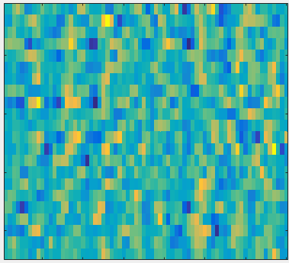
Conv2D
LFCC Features
26 Dim
History Features
EEG Signal
Posteriors
6 Dim
SEIZ
BCKG
CNN Layer 1

