Slide 1
Seizure Image Detection

Slide 2
Overall View
Local Normalization
Conversion to Image
Conversion to HDF5
Decimation to 50Hz
ResNet18
Postprocessing
Sens.: 47.36%
FAs/24Hr.: 5.09

Slide 3
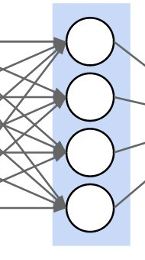
ResNet18 Blocks
Input
(D₁, D₂)
Basic Block
(D₁, D₂)
Conv2D@D₁xD₂
kernel: 7x7
stride: 2x2
padding: 3x3
MaxPool2D@D₁xD₂
kernel: 3x3
stride: 2x2
padding: 1x1
dilation: 1x1
Conv2D@D₁xD₂
kernel: 3x3
stride: 1x1
padding: 1x1
Conv2D@D₂xD₂
kernel: 3x3
stride: 1x1
padding: 1x1
BatchNorm@D₂
BatchNorm@D₂
BatchNorm@D₂
ReLU
ReLU
Downsample
(D₁, D₂)
Output
(D₁, D₂)
Conv2D@D₁xD₂
kernel: 1x1
stride: 2x2
padding: 1x1
BatchNorm@D₂
Average Pooling
Linear@D₁ to D₂

Slide 4
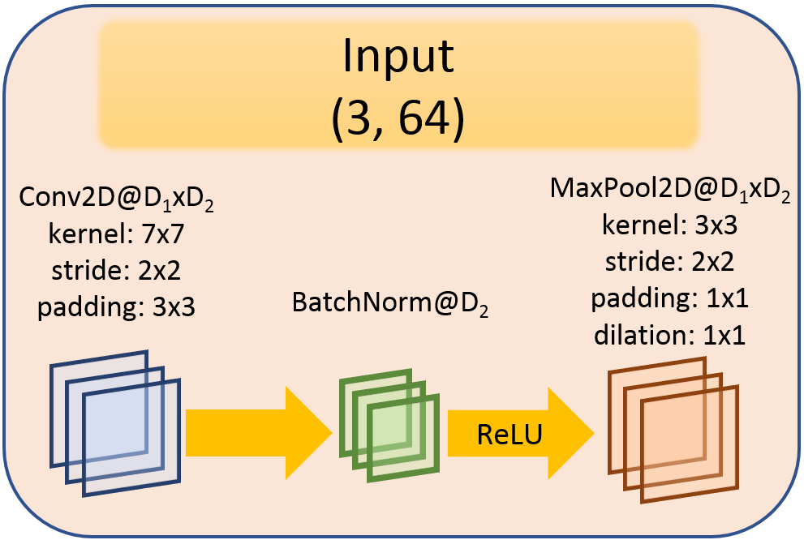
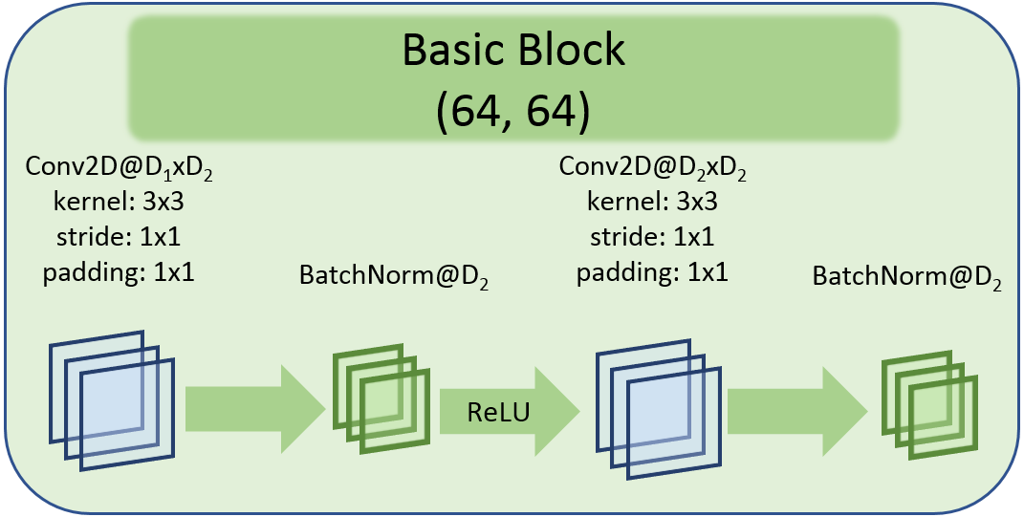
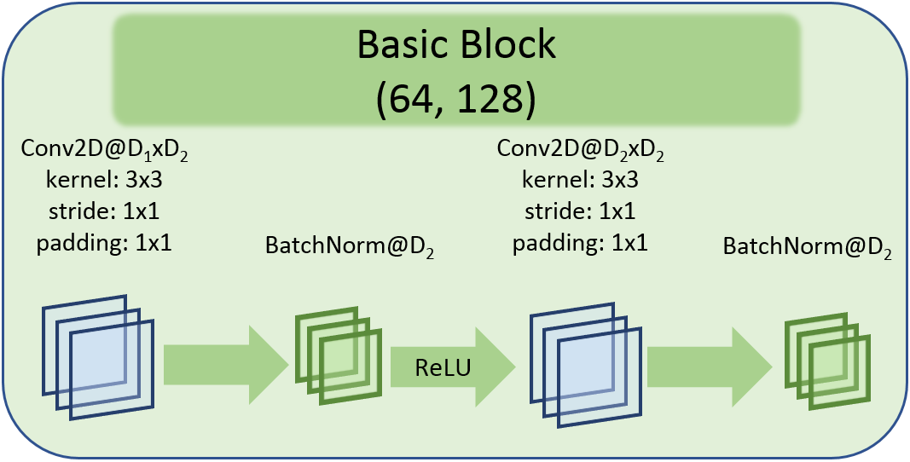
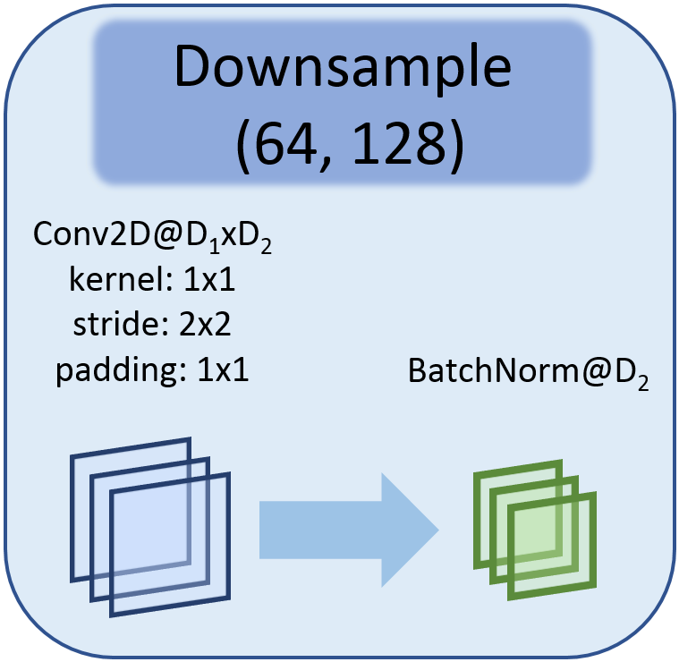
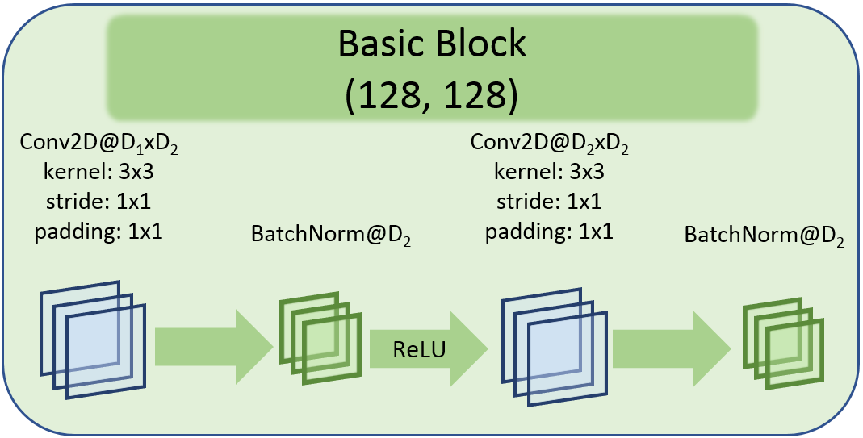
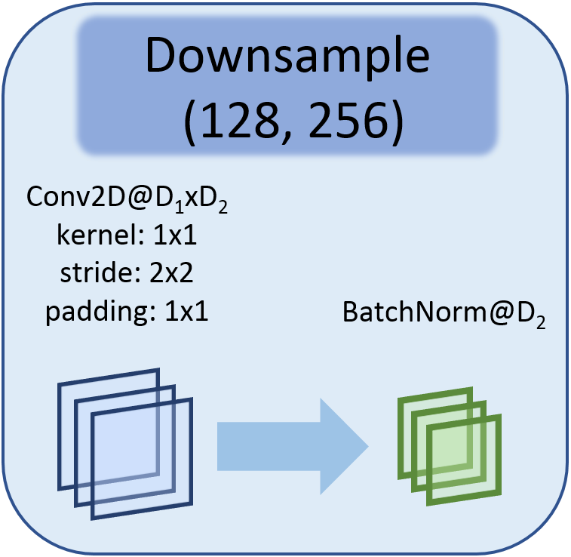
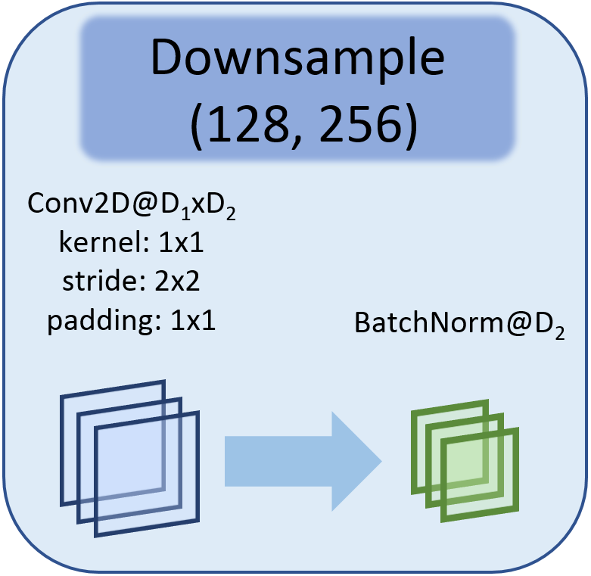
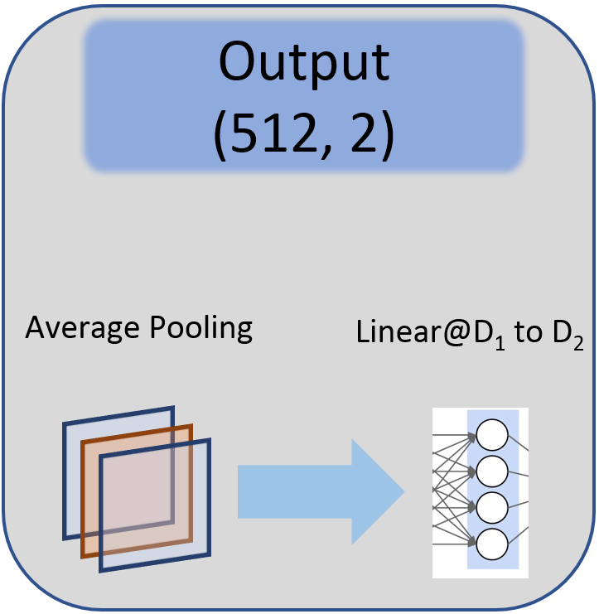
ResNet18 Diagram
Input Layer
Layer 1
Layer 2
Layer 3
Layer 3
Output Layer

Slide 5
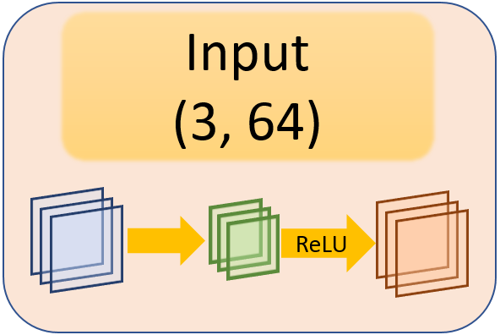
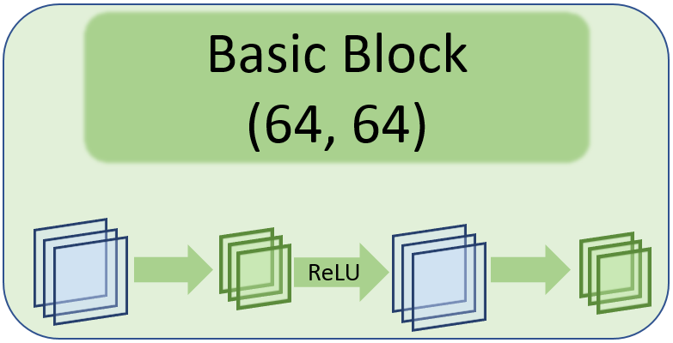
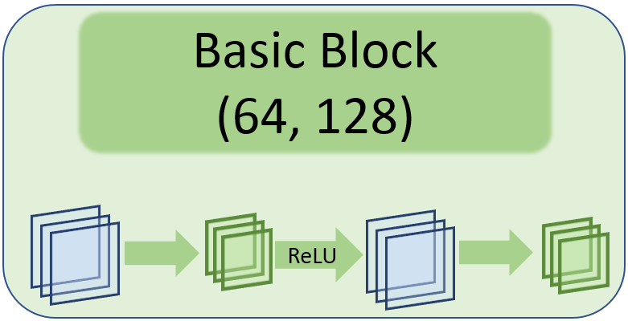
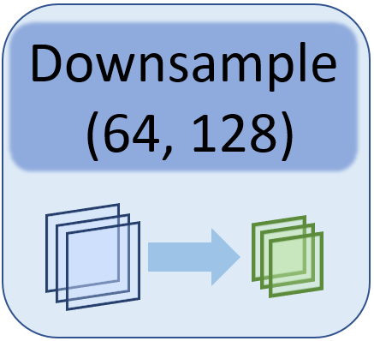
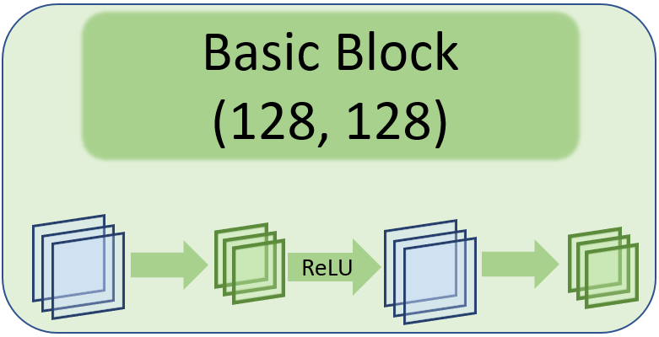
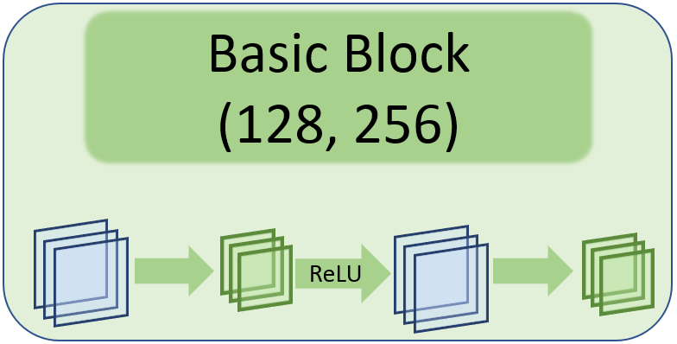
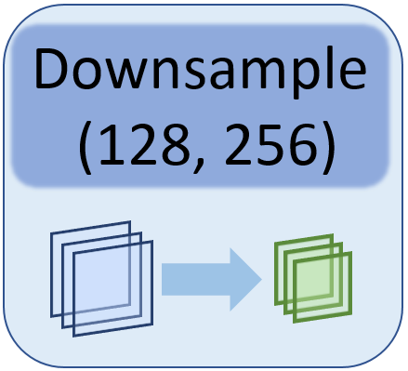
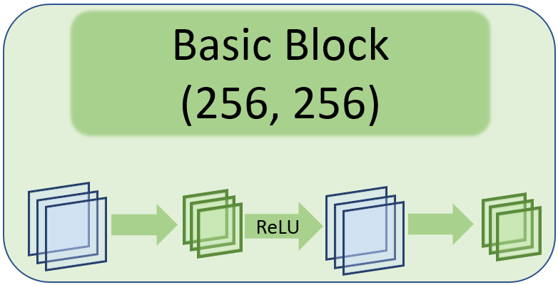
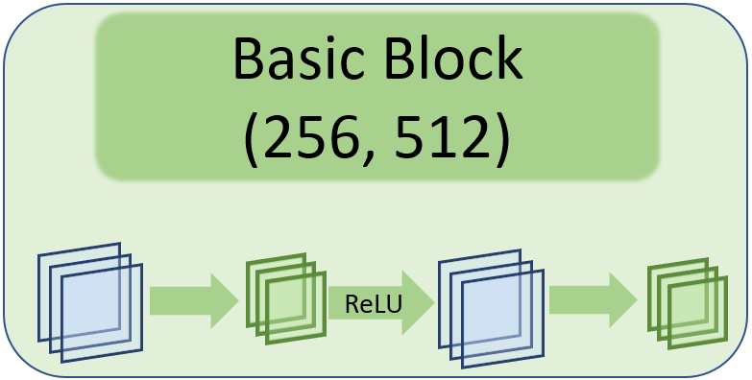
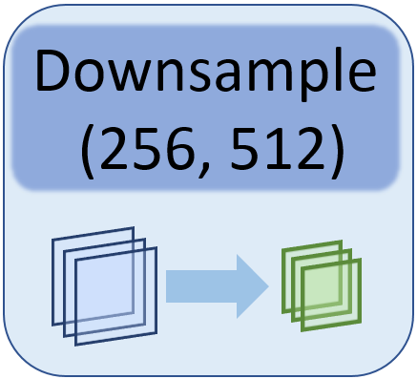
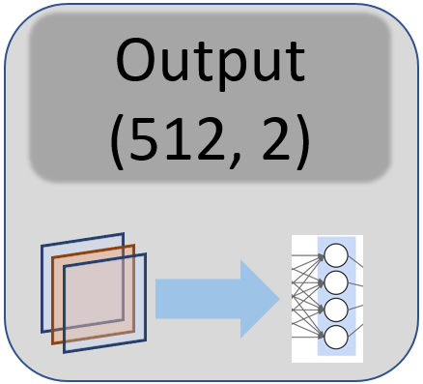
Input Layer
Layer 1
Layer 2
Layer 3
Layer 3
Output Layer

Slide 6
Input
(D₁, D₂)
Conv2D@D₁xD₂
kernel: 7x7
stride: 2x2
padding: 3x3
MaxPool2D@D₁xD₂
kernel: 3x3
stride: 2x2
padding: 1x1
dilation: 1x1
Basic Block
(D₁, D₂)
Downsample
(D₁, D₂)
BatchNorm@D₂
ReLU
Conv2D@D₁xD₂
kernel: 3x3
stride: 1x1
padding: 1x1
Conv2D@D₂xD₂
kernel: 3x3
stride: 1x1
padding: 1x1
Conv2D@D₁xD₂
kernel: 1x1
stride: 2x2
padding: 1x1
BatchNorm@D₂
BatchNorm@D₂
BatchNorm@D₂
ReLU
 | Input Layer | Layer 1 | Layer 2 | Layer 3 | Layer 4 | Output
Input | (3, 64) | --- | --- | --- | --- | ---
Basic Block | --- | (64, 64) | (64, 128) | (128, 256) | (256, 512) | ---
Downsample | --- | --- | (64, 128) | (128, 256) | (256, 512) | ---
Basic Block | --- | (64, 64) | (128, 128) | (256, 256) | (512, 512) | ---
Output | --- | --- | --- | --- | --- | (512, 2)
Output
(D₁, D₂)
Average Pooling
Linear@D₁ to D₂

