Slide 1
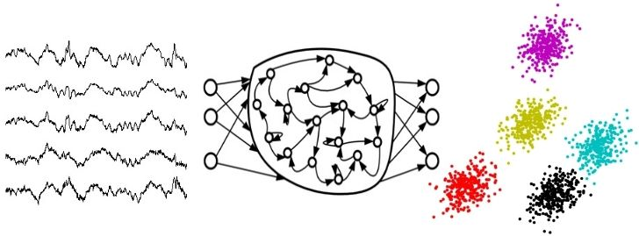
Deep Learning Time Series Classification and Clustering
Presented By:
Vahid Khalkhali
Department of Electrical and Computer Engineering,
Temple University
Submitted to:
Advisor:
Dr. Joseph Picone, Dept. of Electrical and Computer Engineering
Committee:
Dr. Iyad Obeid, Dept. of Electrical and Computer Engineering
Dr. Albert Kim, Dept. of Electrical and Computer Engineering
Dr. Pallavi Chitturi, Committee Member, Fox School of Business
External Reader:
Dr. Georgios Lazarou, Dept. of Electrical and Computer Engineering, University of South Alabama

Slide 2
Abstract
Time series classification and clustering poses some challenges:
Most of real-world time series are nonstationary.
Manual annotation of time series are usually an errorful and expensive process.
Unsupervised deep learning can help achieve high performance without the need for an extensive amount of manually annotated data.
Two convolutional autoencoders were able to achieve the comparable performance of the current state-of-the-art hierarchical vote system (HIVE-COTE) with much less computational complexity on the well-known time series database from University of California, Riverside/University of East Angola (UCR/UEA).
An autoencoder with deep neural network trained with K-MEANS clustering and augmented samples achieves good results in several datasets of the UCR/UEA time series database.
An Echo State Network (ESN) autoencoder achieved reconstruction accuracy of 98.33% that passed the autoregressive (AR) models’ accuracy of 93.67% on EEG signals.
Notes:
Using stationary methods are usually very inefficient.
To decrease annotation error rates, annotation of the same data by multiple experts is needed, and that further drives up the cost of producing large amounts of data.

Slide 3
Three Selected Papers
The papers reviewed for this preliminary exam were:
Ismail Fawaz, H., Forestier, G., Weber, J., Idoumghar, L., & Muller, P. A. (2019). Deep learning for time series classification: a review. Data Mining and Knowledge Discovery, 33(4), 917–963. https://doi.org/10.1007/s10618-019-00619-1.
Ma, Q., Zheng, J., Li, S., & Cottrell, G. W. (2019). Learning representations for time series clustering. Advances in Neural Information Processing Systems, 32(NeurIPS). https://papers.nips.cc/paper/8634-learning-representations-for-time-series-clustering.
Sun, L., Jin, B., Yang, H., Tong, J., Liu, C., & Xiong, H. (2019). Unsupervised EEG feature extraction based on echo state network. Information Sciences, 475, 1–17. https://doi.org/10.1016/j.ins.2018.09.057.

Slide 4
Table of Contents
Introduction
Generative or discriminative approaches
Datasets
Classification with Deep Neural Network (DNN)
Multi-Layer Perceptron (MLP)
Time Convolutional Neural Network (TCNN)
Fully Convolutional Neural Network (FCN)
Residual Network (ResNet)
Multi-scale Convolutional Neural Network (MCNN)
Multi-Channel Deep Convolutional Neural Network
Time Le-Net
Echo State Networks (ESN)
Encoder
Classification Experiment and Results
Unsupervised Clustering
Deep Temporal Clustering Representation (DTCR)
Unsupervised EEG Feature Extraction Based on Echo State Network
Conclusion
References

Slide 5
Introduction
A “time series” is a term that can be used for every sequence of numbers or values changing through time or any other units rather than time.
For example, sales of a product during several months is a time series, while a stream of characters or words in a sentence is also a time series. In the former case the time is exclusively implied, while in the latter case, the order inclusively shows the variation during the time.
A signal can be defined as a time series that convey information.
The duration of signals and their dimensions are usually more than time series.
In supervised classification, the categories are known, and the task is to find the patterns of each category.
Problem: Finding Complex Patterns
In unsupervised clustering, the categories are determined based on the similarity of signals.
Problem: Similarity (Point-wise, shape, trend, frequency domain, etc.)

Slide 6
Generative or discriminative approaches
Generative
Discriminative
Assumes a model
Finds values of parameters
Detects, predicts and generate
Finds a mapping between input data and output
Engineered features
End-to-end systems
Classifiers
Detects and predicts
Autoencoders, Deep belief networks (DBN), etc.
Traditional classifiers with time/frequency features, Convolutional neural networks (CNN)
Notes:
Contrary to feature extraction methods, since learning good features need a good amount of domain knowledge and also making a good mathematical interpretation of this knowledge, then it is more preferable to have general methods to learn features without having domain-specific knowledge.
The MLP can be used to learn temporal information but as discussed before, the features are not time-invariant. Instead, CNN can learn time-invariant features from raw input time series. Also, because of its quick training process, it is a very favorable architecture in time series analysis.
In this review document, we will talk about discriminative approaches in the classification part while the generative approaches will be discussed in the unsupervised section. This selection is planned because, in practice, discriminative approaches usually have better classification or discriminative abilities while they cannot be useful when interacting with unsupervised learning since they are highly dependent on training data.

Slide 7
Datasets
Two datasets have been used for evaluation
UCR/UEA (Dau et al., 2019): univariate
Categories: 85
Duration: 24 to 2709
Number of classes for each category: 2 to 60
Number of samples for each category: 16 to 8926
Normalization: z-normalized
There are many publications on this dataset, therefore, good for comparison.
Baydogan (Baydogan, 2015): multivariate
Classes: 13
EEG:
The Bonn University epileptic seizure dataset
Five subsets (denoted A-E), each containing 100 single-channel EEG signals of 23.6 seconds duration (4097 samples).
Kaggle EEG datasets
These EEG signals are sampled at 173.61 Hz and Band-pass filtered at 0.53-40 Hz (12 dB/oct).

Slide 8
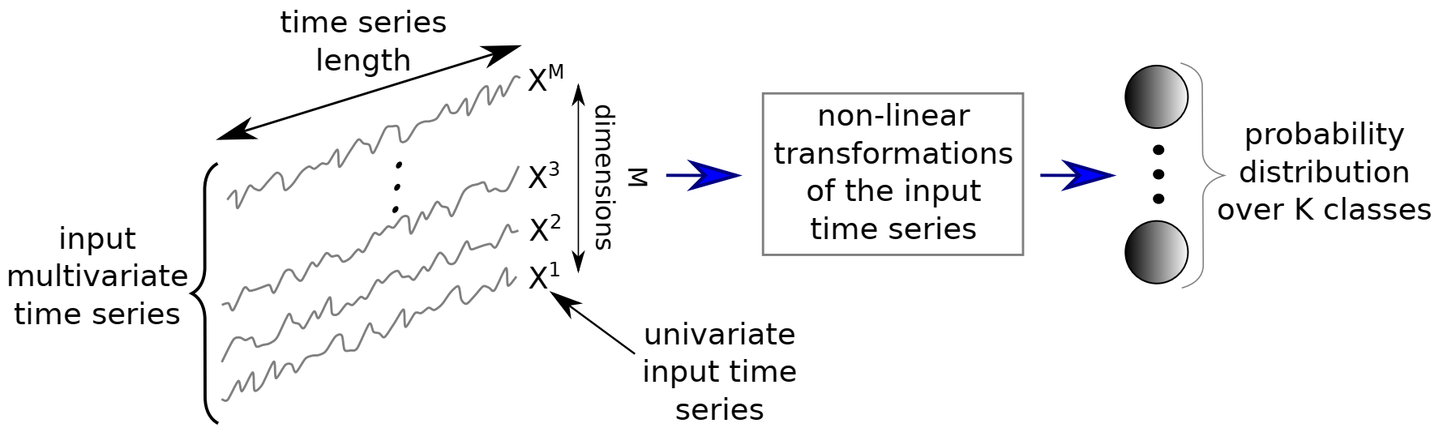
Classification with Deep Neural Network (DNN)
A univariate time series with length T ➔ $X=\left[x_{1},x_{2},⋯,x_{T}\right]$
An M-dimensional time series ➔ $X=\left[X^{1},X^{2},⋯,X^{M}\right]$
A dataset ➔ $D=\left\{\left(X_{1},Y_{1}\right),\left(X_{2},Y_{2}\right),⋯,\left(X_{N},Y_{N}\right)\right\}$
The task of classification is to find a map from the space of possible inputs to a probability distribution over the class variable values or labels.
$f_{L}\left(θ_{L},x\right)=f_{L−1}\left(θ_{L−1},f_{L−2}\left(θ_{L−2},f_{L−3}\left(θ_{L−3},⋯,f_{1}\left(θ_{1},x\right)\right)\right)\right)$
The architecture of the neural network is defined as the ways that neurons are connected.
Many modifications are built to main problems in DNNs:
Regularization such as l2-norm weight decay and Dropout to reduce overfitting by limiting the number of free parameters.
Data Augmentation to increase the number of training samples and help the network learn the desired patterns instead of artifacts.

Slide 9
Multi-Layer Perceptron (MLP)
MLP is fully-connected (FC) which means that every neuron’s input in each layer comes from all the neurons of the previous layer.
The links between neurons carry weights and non-linearity achieved by trigger functions at each neuron.
$A_{l_{i}}=f\left(ω_{l_{i}}∗X+b\right)$
A 4 layer fully connected MLP with 500 neurons in each layer, ReLU activation function, and the softmax output layer has been used. The layers are followed by a dropout operation with rates equal to 0.1, 0.2, and 0.3, respectively.
The input dimensions in MLP are not time/spatial invariant. In other words, each timestamp has its weight, and the temporal information is lost. Hence, the MLP transferability is not trivial; the number of parameters (weights) of the network depends directly on the length of the input time series and the length of time series must be kept fixed.

Slide 10
Time Convolutional Neural Network (TCNN)
Applying sliding window filtering on a time series help to analyze it in multiresolution.
Therefore, like what human use to interpret an image or signal, not only the local variations will be considered, but also global trends will be extracted.
$C_{t}=f\left(ω∗X_{t−\frac{l}{2}:t+\frac{l}{2}}+b\right) | ∀ t ∈[1, T]$
The Convolution operation help the network to learn weights which are invariant across time dimension.
Max pooling or averaging is done after each layer and the final layer is usually a fully connected linear layer.
Time-CNN has three main differences compared to traditional CNN
For training, instead of the cross-entropy loss function, the mean square error (MSE) has been used.
Max pooling is replaced by average pooling.
The fully-connected (FC) layer at the output was removed completely and the output of convolutional layers is directly connected to the output sigmoid functions.
The Time-CNN has two consecutive convolutional layers with 6 and 12 filters respectively and a local average pooling operation with a length of 3.

Slide 11
Fully Convolutional Neural Network (FCN)
Fully Convolutional Neural Networks are mainly convolutional networks that do not contain any local pooling layers which means that the length of a time series is kept unchanged throughout the convolutions.
Another important difference between this network and the traditional ones is the replacement of the FC final layer with a Global Averaging Pooling (GAP) layer which is resulted in a drastic reduction of the number of parameters of the network.
The Wang et al. architecture has three convolutional layers with ReLU activation followed by batch normalization. The final layer is a GAP with the softmax activation function. In all convolutional layers, the stride has been chosen to be equal to one to preserve the length of the time series. The number and length of filters for the layers are 128 with 8, 256 with 5, and 128 with 3, respectively. The proposed FCN architecture has one important advantage; time-invariancy. By time-invariant property, the time series can have any length.

Slide 12
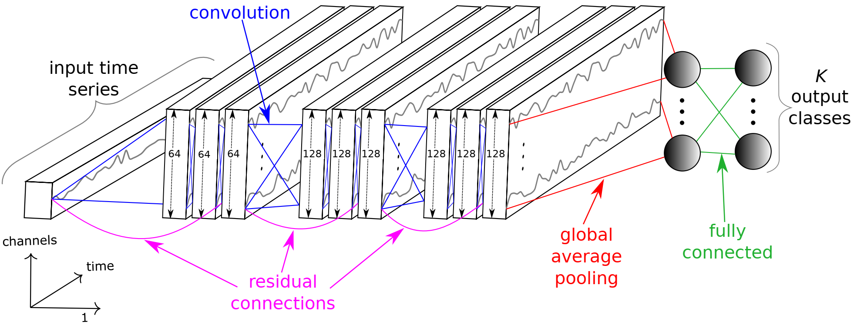
Residual Network (ResNet)
The ResNet (Figure 4) has given a very good response in image processing and other fields.
The proposed ResNet that has been used here has 11 layers which the beginning 9 of which are convolutional. The final layer is just a softmax activation and the layer before it is a GAP.
Besides the deeper architecture of ResNet in comparison to FCN, there are residual connections between consecutive convolutional layers. This helps gradients to flow directly through the network and reduce the vanishing gradient effect.
The number of filters is kept fixed to 64 which everyone is followed by batch normalization operation. The durations of residual blocks’ filters are 8, 5, and 3.
The ResNet is time invariant, and it enables the usage of transfer learning. It means that the network can be trained in several datasets without the need to change the number of neurons or architecture of networks.

Slide 13
Multi-scale Convolutional Neural Network (MCNN)
A Multi-scale Convolutional Network (MCNN) is a traditional CNN model with two convolutions (and max pooling) followed by an FC layer and softmax.
Window slicing (WS) is used for data augmentation.
They have done identity mapping, downsampling, and smoothing on these WS, and then trained the network. By these three transformations, univariate WS will convert to multivariate input.
This heavy preprocessing makes questions if it can be assumed as an end-to-end approach.
There are 4 layers in the network, each layer has 256 filters with sigmoid activation and max pooling. The first two layers of the network are designed to be time-invariant.
The majority votes over all WSs in a time series are used for final detection.

Slide 14
Multi-Channel Deep Convolutional Neural Network
MCDCNN is a CNN that has been modified to work with multivariate time series (MTS) by using separate CNNs for separate channels.
Two convolutional stages with 8 filters of length 5 with ReLU activation and max-pooling with length 2. All channels’ second layer output goes to an FC layer with 732 neurons and ReLU activation. The softmax layer is used as an output.
The FC layer limits the transferability of the network to the first and second convolutional layers.

Slide 15
Time Le-Net
The t-LeNet is a CNN with 2 convolutional layers followed by an FC layer and softmax.
Unlike FCN, local pooling is used instead of global pooling.
Since the convolutional layers are limited and there is an FC layer instead of GAP, the transferability of the network is not possible. It means that if the duration of input increases, the network needs to be retrained.
t-LeNet uses data augmentation to prevent overfitting. In their work, they have used WS and Window Warping (WW) for data augmentation. Similar to MCNN, since they use WS, voting for final detection is necessary.

Slide 16
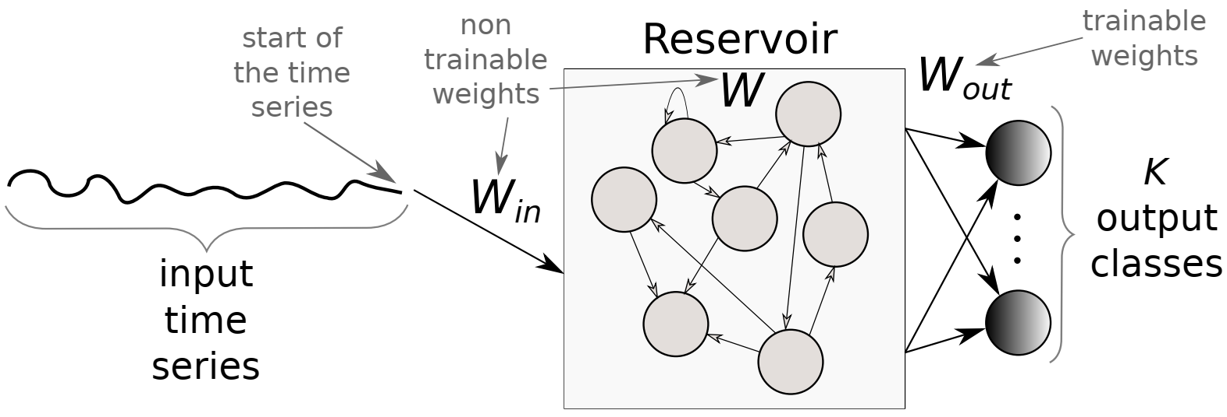
Echo State Networks (ESN)
Recurrent Neural Network (RNN) is designed for time-series regression and classification.
Unfortunately, RNNs suffer from vanishing gradients during the training process.
Echo State Networks (ESN) eliminates the need to compute the gradient for the hidden layers.
The reservoir, a sparsely connected random RNN, is the core of an ESN.
The only weights which will be optimized are output weights with a learning algorithm.
In ESNs, three parameters need to be optimized; the reservoir’s size, sparsity, and spectral radius.
Time Warping Invariant Echo State Network (TWIESN) is a non-convolutional recurrent network that has been used here.
The reservoir in ESN is used to project the elements of time series to a higher dimension space. Thus, the elements of the univariate time-series will be combined in a complete nonlinear manner to a higher dimension because of the reservoir. Then these highly nonlinear features are fed to a Ridge classifier to predict the class of each time-series.

Slide 17
Encoder
Similar to FCN with the following differences:
The last layer (GAP layer) is replaced with an attention layer.
The PReLU activation has been used instead of ReLU. This facilitates the learning of the slope of the function.
The dropout regularization has been used to avoid vanishing gradients.
Max-pooling operations for overfitting prevention.
This network, like FCN, is time-invariant and it can work with time-series with the variable-length duration.

Slide 18
Summary of Neural Networks
Architecture’s hyperparameters for the deep learning approaches
Optimization’s hyperparameters for the deep learning approaches

Slide 19
Classification Experiment and Results (1 of 9)
Since there are random parameters, each model will be trained and evaluated 10 times and the mean of results will be selected as the model’s result.
Keras and TensorFlow have been used as backend.
Deeper networks have better efficiency because they can learn more complicated patterns with a smaller number of neurons.
Between deep learning methods, ResNet has significantly the best average rank, because:
With some modification in pure CNN, such as max-pooling and residual broadcast, it generalizes better on unseen data than pure CNN.
The convolutional layers can learn sequential patterns very well. These sequential patterns may be spatial like images or temporal like signals.
MCNN and t-LeNet architectures yielded very low performance because learning the overall patterns of a time series just by using small slices of them is not possible. Therefore, Window Slicing is not a successful approach.
The Encoder’s result was mediocre. This indicates that for time series, the final GAP layer gives better discriminative performance compared to the final attention mechanism layer.

Slide 20
Classification Experiment and Results (2 of 9)
Comparison with non-deep methods:
Nearest Neighbor Dynamic Time Warping (DTW) with Warping Window (NN-DTW-WW)
Elastic Ensemble (EE) is an ensemble of nearest neighbor classifiers with 11 different time series similarity measures.
Proximity Forest (PF) which is similar to Random Forest uses a random similarity measure chosen out of EE’s elastic distances.
Bag-of-SFA-Symbols (BOSS) is a discriminative bag of words that uses Discrete Fourier Transform as features and the nearest neighbor classifier with a bespoke distance measure.
Shapelet Transform (ST) extracts discriminative subsequences (shapelets) and builds a new representation of time series that consists of 8 classifiers.
Collective of Transformation-based Ensembles (COTE) is a weighted ensemble of 35 TSC (time series clustering) algorithms including EE and ST.
Hierarchical Vote Collective of Transformation-Based Ensembles (HIVE-COTE) improves COTE’s performance significantly by using a hierarchical voting system as well as adding two new classifiers and two additional transformation domains.

Slide 21
Classification Experiment and Results (3 of 9)
The median accuracy of ResNet has been compared to state-of-the-art classifiers.
The statistical test failed to find any significant difference between COTE/HIVE-COTE and ResNet.
ResNet is the only deep learning algorithm that can reach the COTE performance.
NN-DTW-WW and EE showed the lowest performance that indicates these algorithms cannot compete with state-of-the-art algorithms anymore.
HIVE-COTE is still the most accurate classifier on UCR/UEA, its training time complexity makes it infeasible in many applications. Its time complexity is O(N².T⁴) which is proportional to the training time of ST (Shapelet) which is too slow.
The parameters of ResNet were not tuned for UCR/UEA dataset to keep the generality. For example, in HIVE-COTE, the DTW warping area or the number of k in kNN have been tuned to this dataset. Thus, the performance of ResNet may increase by this tuning.
ResNet did very well on several unrelated themes.

Slide 22
Classification Experiment and Results (4 of 9)
For multivariate cases, a little different result was derived. Although Time-CNN and MCDCNN were originally proposed for MTS, three deep CNNs (ResNet, FCN, and Encoder) outperformed them.
The statistical test failed to find any significant differences between nine classifiers which is because of the small number of samples in the dataset.
Therefore, the results of both datasets were used and the critical difference diagram of both datasets is shown. Again, since there are 85 datasets in UCR/UEA in comparison to 12 MTS datasets in Baydogan, a significant difference between Figures cannot be observed.

Slide 23
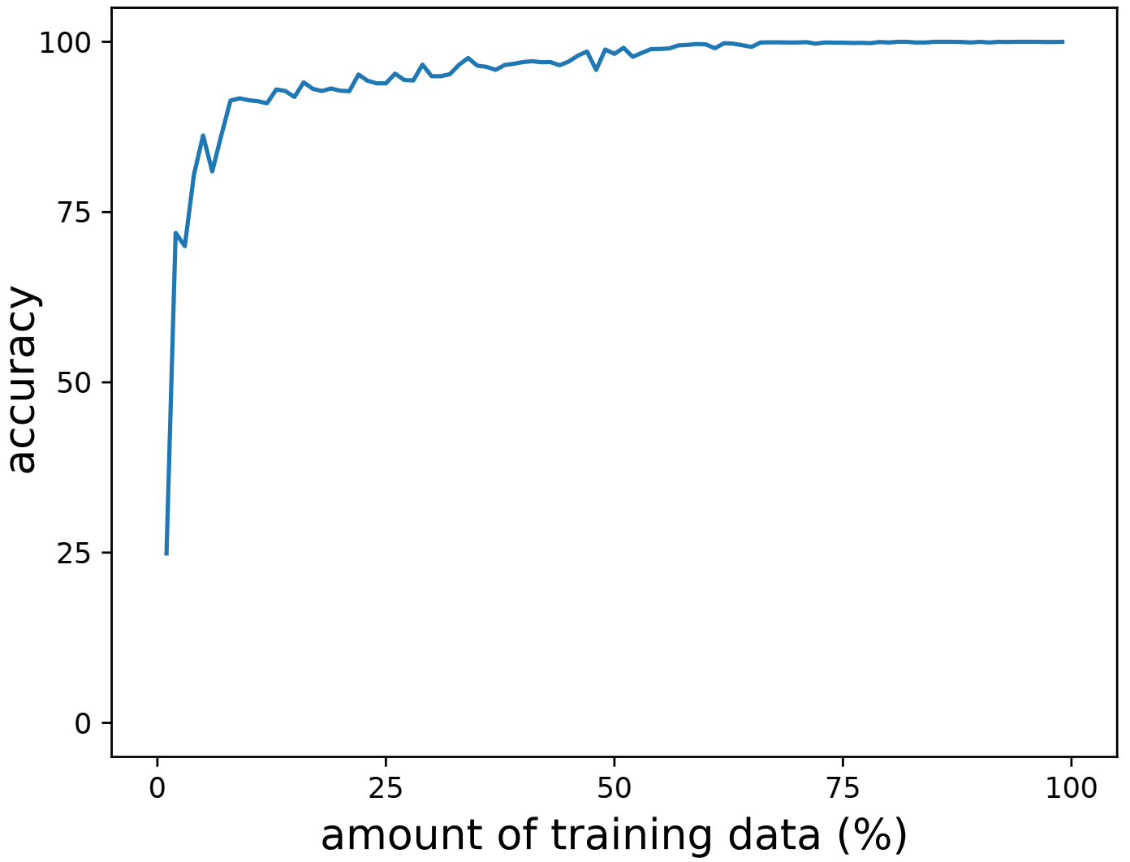
Classification Experiment and Results (5 of 9)
The response of every classifier to different durations of time series is shown in the above Table.
The similarity of classifiers’ ranks in the above Table and ranks’ Figure (from last slide) depicts that DNNs are almost insensitive to the duration of time series.
The concerns about the duration of time series become important when the time series gets very long. Some classifiers have vanishing gradient problem in the training step. The ESN is one of the classifiers which can handle very long time series without vanishing gradient problems.
Investigation on the number of samples in the train set shows that, in practice, on very small size datasets, the performance of ResNet and FCN becomes very poor in comparison with competitors because of overfitting.

Slide 24
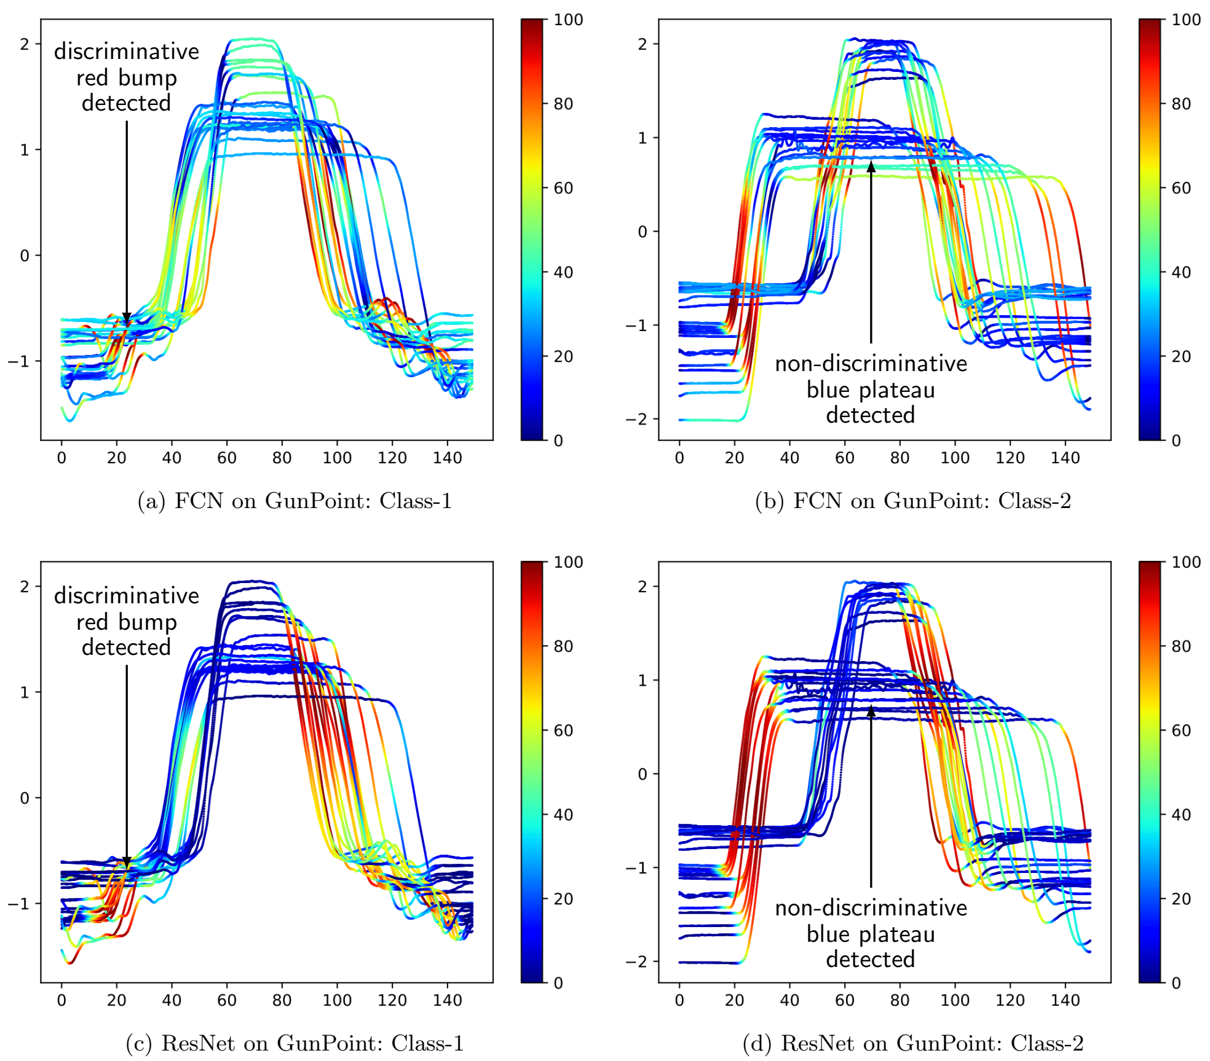
Classification Experiment and Results (6 of 9)
The Class Activation Map (CAM) helps an interpretable visualization method to find out how a classifier works.
The CAM highlights the parts of an image that contributes the most to a given class.
Both classifiers neglecting the plateau non-discriminative regions.
Both classifiers find out the most critical points.
The CNN works as it was expected, e.g. they found local discriminative areas regardless of where they appeared in time series; which shows CNN is a time-invariant classifier.

Slide 25
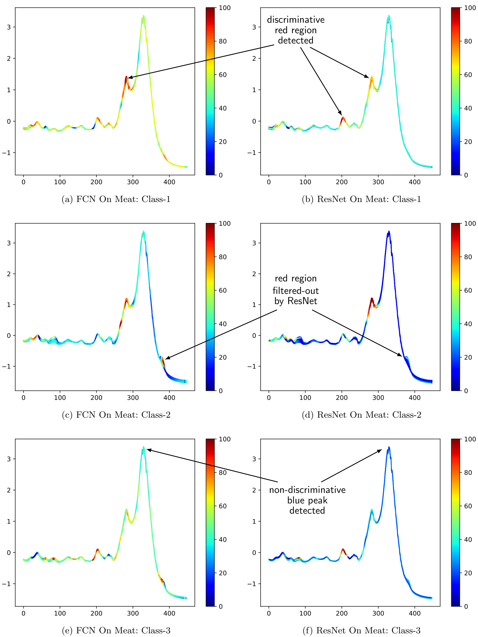
Classification Experiment and Results (7 of 9)
This dataset has three classes and ResNet and FCN accuracy were different with 97% and 83% respectively.
The darker colors of ResNet show more certainty about the decisions while the light color of FCN shows it could not find complete distinctive areas.
This observation is very strong for class 2 where ResNet completely rejects the discriminative capability of some areas while FCN thinks they are discriminative yet.

Slide 26
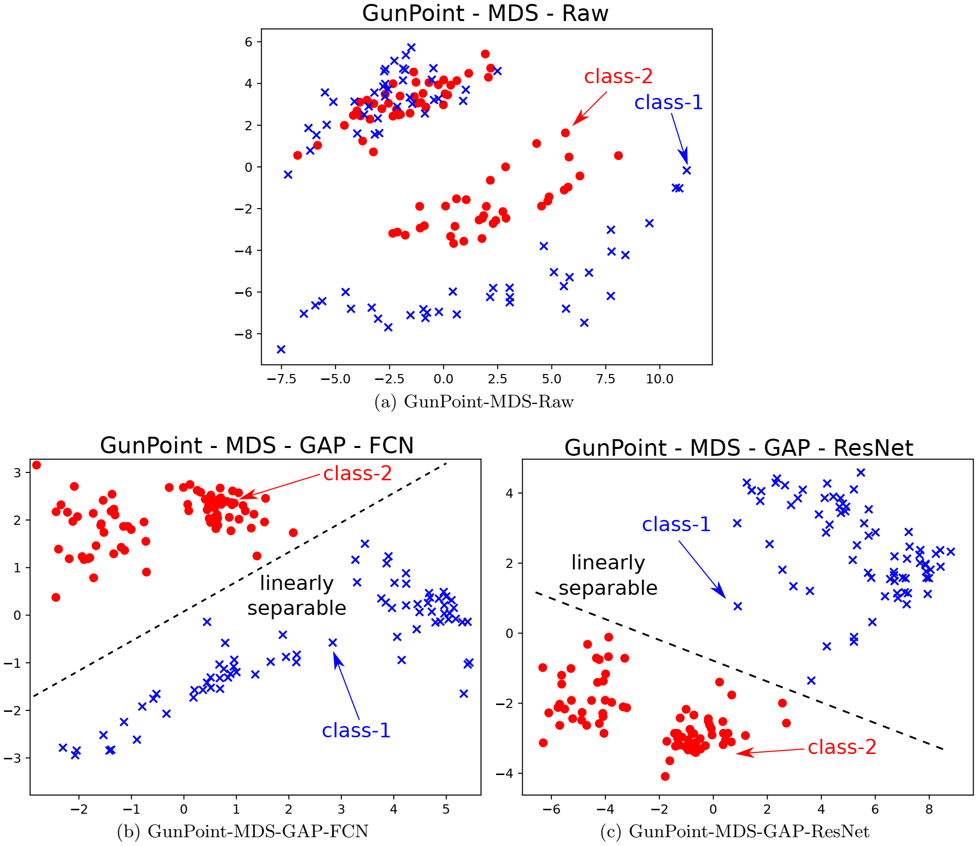
Classification Experiment and Results (8 of 9)
Another good method for visualization of individual samples spatially is Multi-Dimensional Scaling (MDS).
With this plot, it is possible to find out the separability capacity of a specific classifier in comparison to its competitors.
This figure shows three MDS plots for the GunPoint dataset in three formats; the raw input time series, the learned latent features from the GAP layer for FCN and ResNet.

Slide 27
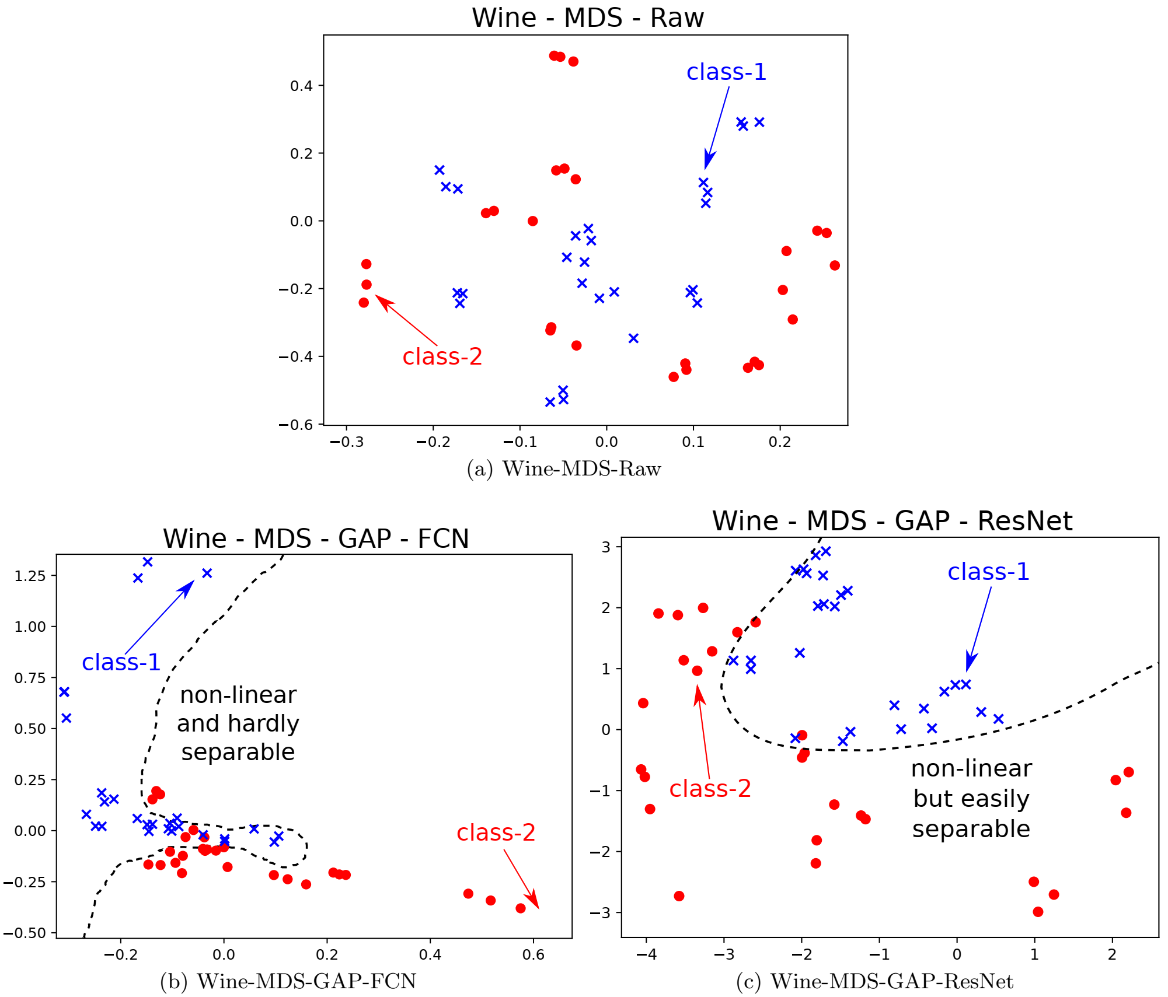
Classification Experiment and Results (9 of 9)
With FCN transformation, as it can be seen in this figure, the separator surface is complex and hard to extract.
It is obvious that ResNet transformation makes it possible to have a very smooth separator surface. This smooth separator surface can be a good reason that why the ResNet gives better results compared to FCN.

Slide 28
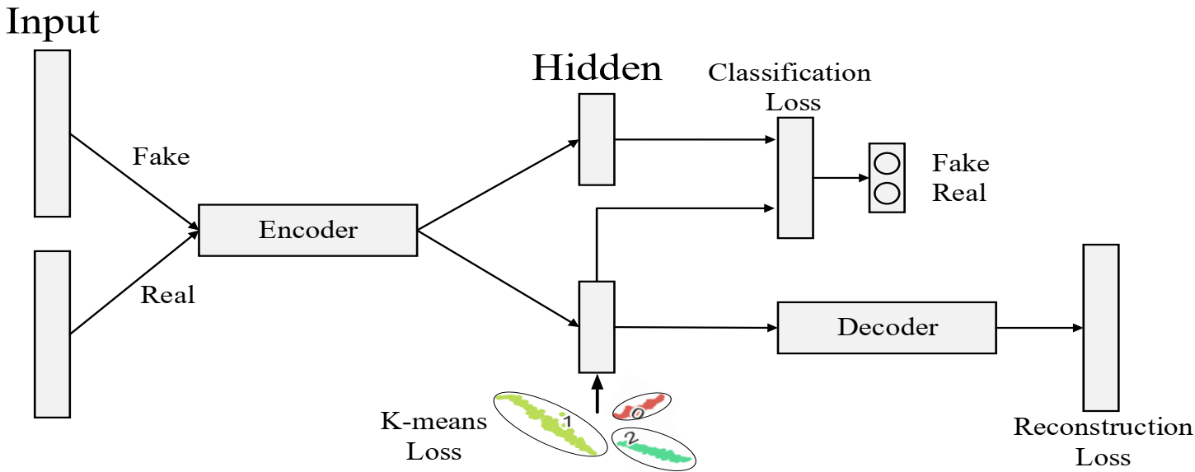
Deep Temporal Clustering Representation (DTCR)
DTCR aims to learn a nonlinear temporal representation for time series clustering using the seq2seq model.
The encoder maps the original time series into a latent space of representations.
The representations are used to reconstruct the input data with the decoder. Simultaneously, a K-MEANS objective guides the representation learning.
The goal is to train a good $f_{enc}$ to facilitate the clustering task.
The dilated RNN is used to implement this nonlinear encoder.
$$f_{enc}:x_{i}→h_{i}$$
$$f_{dec}:h_{i}→{\hat{x}}_{i}$$
$$ℒ_{reconstruction}=\frac{1}{n}\sum_{i=1}^{n}{{\left\|x_{i}{−\hat{x}}_{i}\right\|}_{2}^{2}}$$

Slide 29
Deep Temporal Clustering Representation (DTCR)
The features learned from optimizing the reconstruction loss are not necessarily suitable for clustering tasks. To have a better cluster-specific representation, the network learning will be guided further through K-MEANS.
With a static data matrix $H∈ℝ^{m×N}$, it has been shown that the minimization of K-MEANS could be reformulated as a trace maximization problem with the Gram matrix $H^{T}H$ which produces optimal global solutions without local minima.
Spectral relaxation converts the K-MEANS objective into the following problem:
$$ℒ_{reconstruction}=Trace\left(H^{T}H\right)−Trace\left(F^{T}H^{T}HF\right)$$
$$f_{enc}:x_{i}→h_{i}$$
$$f_{dec}:h_{i}→{\hat{x}}_{i}$$
$$ℒ_{reconstruction}=\frac{1}{n}\sum_{i=1}^{n}{{\left\|x_{i}{−\hat{x}}_{i}\right\|}_{2}^{2}}$$

Slide 30
Deep Temporal Clustering Representation (DTCR)
Spectral relaxation converts the K-MEANS objective into the following problem:
This further relaxed to a trace maximization problem by setting F to be an arbitrary orthogonal matrix:
The closed-form solution of F is obtained by composing the first k singular vectors of H according to the Ky Fan theorem. However, in this case, H is learned by the network instead of being static. This change the equation as a regularization term for learning H. Thus, the target is to minimize the objective below (λ is a scaler):
The augmented samples can improve the encoder quality. Given a time series, its fakes version by randomly shuffling some time steps will be generated.
$$ℒ_{reconstruction}=Trace\left(H^{T}H\right)−Trace\left(F^{T}H^{T}HF\right)$$
$$\max_{F}{Trace\left(F^{T}H^{T}HF\right)}, s.t. F^{T}F=I$$
$$\min_{H, F}{J\left(H\right)+\frac{λ}{2}\left[Trace\left(H^{T}H\right)−Trace\left(F^{T}H^{T}HF\right)\right]}, s.t. F^{T}F=I$$

Slide 31
Deep Temporal Clustering Representation (DTCR)
the overall training loss L_DTCR of DTCR is defined by:
This equation is minimized to learn the cluster-specific representations:
$ℒ_{reconstruction}$ makes the representations reconstruct the input
$ℒ_{classification}$ enhances the ability of the encoder
$ℒ_{K−means}$ encourages the representations to form cluster structures.
$$ℒ_{DTCR}=ℒ_{reconstruction}+ℒ_{classification}+λℒ_{K−means}$$
Algorithm 1 DTCR Training Method
Input: Data set: D; Number of clusters: K; Alternate update: T; Maximum iterations: MaxIter
Output: Cluster result s
1: For each time series in D, generate the corresponding fake samples.
2: for iter = 1 to MaxIter do
3: Update latent representation ${\left\{h_{i}=f_{enc}\left(x_{i}\right)\right\}}_{i=1}^{n}$ using SGD based on Equation
$ℒ_{DTCR}=ℒ_{reconstruction}+ℒ_{classification}+λℒ_{K−means}$.
4: if iter % T = 0 then
5: Update F using the closed-form solution of Equation $\max_{F}{Trace\left(F^{T}H^{T}HF\right)}, s.t. F^{T}F=I$.
6: end if
7: end for
8: Apply K-MEANS to the learned representation and get the cluster result s.

Slide 32
Deep Temporal Clustering Representation (DTCR)
The bidirectional multi-layer Dilated RNN is employed for encoding to capture the dynamics and multi-scale characteristics of the time series. The number of layers and dilation per layer are fixed to 3 and 1, 4, and 16, respectively.
The decoder is a single layer RNN with Gated Recurrent Units (GRU).
The number of units per layer of the encoder is $\left[m_{1}, m_{2},m_{3}\right]⊂\{\left[100, 50, 50\right], \left[50, 30, 30\right]\}$. The number of hidden units in the decoder is $(m_{1}+m_{2}+m_{3})×2$.

Slide 33
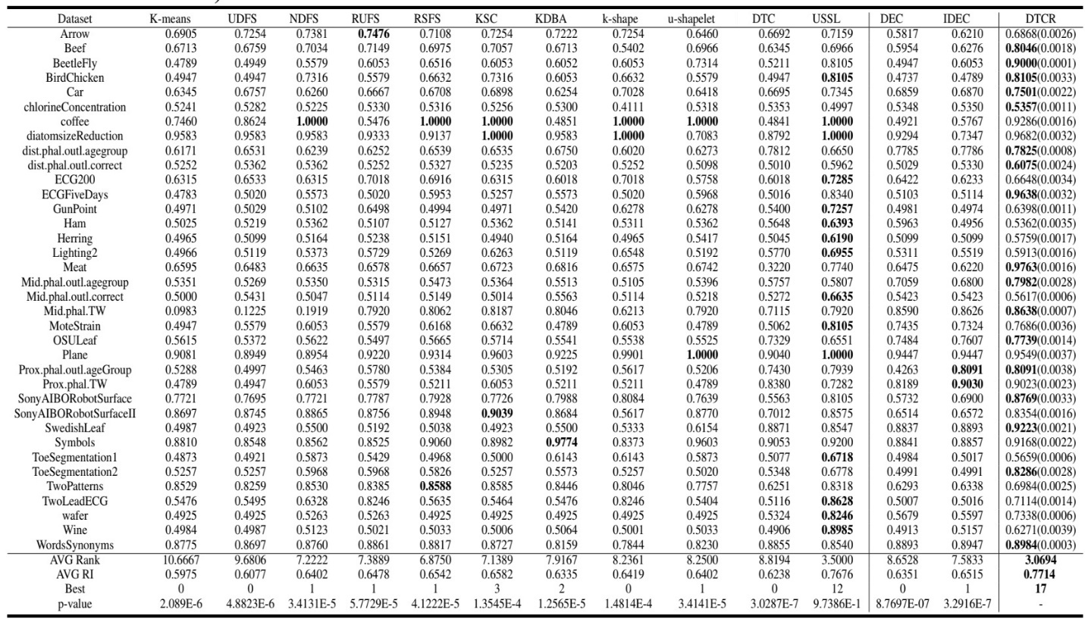
Deep Temporal Clustering Representation (DTCR)
Rand Index (RI) comparisons on 36 time series datasets (the values in parentheses present standard deviations)

Slide 34
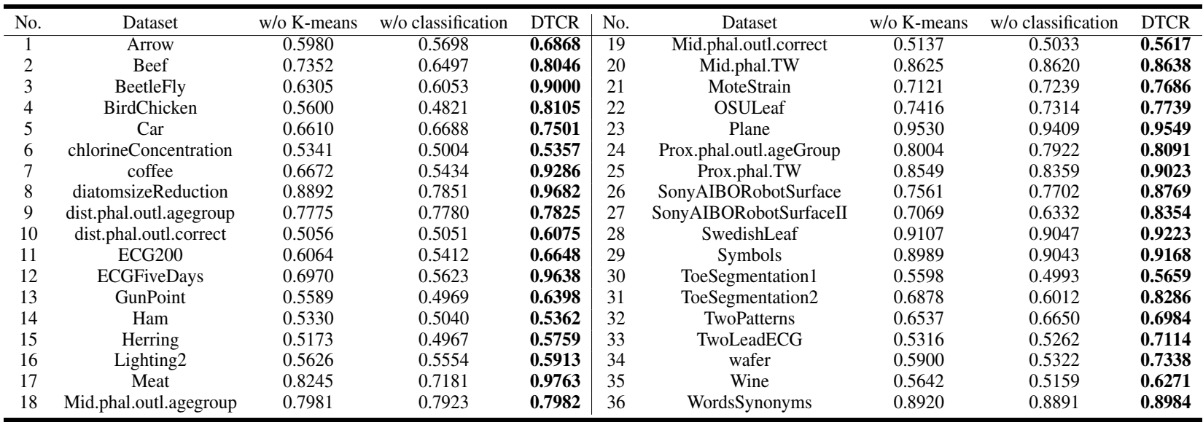
Deep Temporal Clustering Representation (DTCR)
The impact of $ℒ_{K−means}$ and $ℒ_{classification}$ contributions to clustering are shown in the above Table.

Slide 35
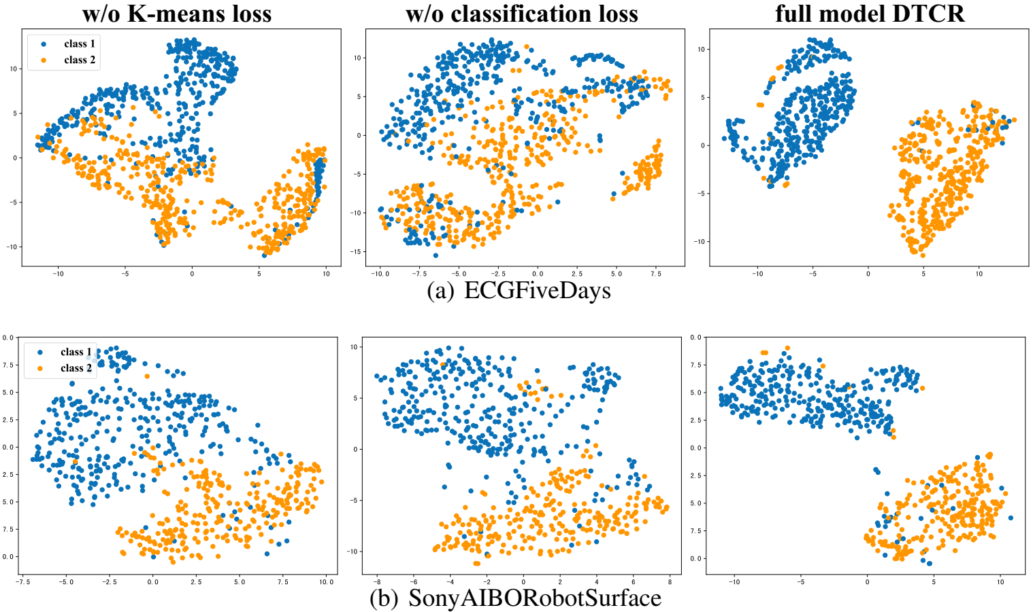
Deep Temporal Clustering Representation (DTCR)
Visualization with t-SNE
Training epochs visualization with t-SNE

Slide 36
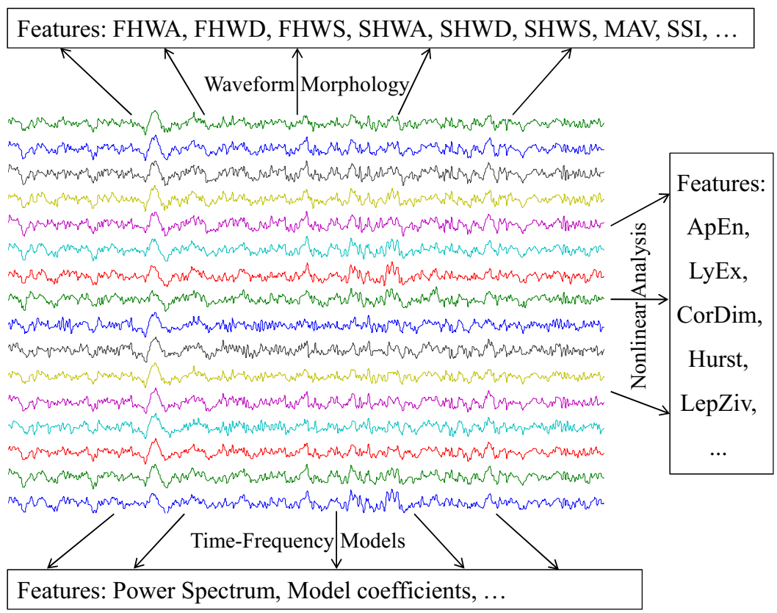
Unsupervised EEG Feature Extraction Based on Echo State Network
Several engineered feature sets from multiple fields have been proposed to numerically describe the EEG signals:
Visual or waveform morphology
First half-wave amplitude (FHWA)
First half-wave duration (FHWD)
First half-wave slope (FHWS)
Second half-wave amplitude (SHWA)
Second half-wave duration (SHWD)
Statistical
Mean absolute value (MAV)
Simple square integral (SSI)
Variance (VAR)
Root mean square (RMS)
Waveform length (WL)
Average amplitude change (AAC)
Model-based
Short-time Fourier transform (STFT)
Discrete wavelet transform (DWT)
Autoregressive (AR) model
Nonlinear indicators
approximate entropy (ApEn)
Lyapunov exponents (LyEx)
Correlation dimension (CorDim)

Slide 37
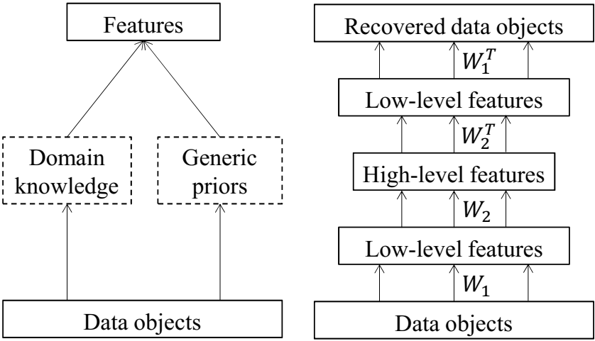
Unsupervised EEG Feature Extraction Based on Echo State Network
It has been observed that for simple tasks finding a good feature set is easy while for complex classification tasks, such as EEG signal case, a great deal of time and effort need to find an acceptable set of features.
Here, the feature extraction echo state networks (FE-ESN) will be implemented on EEG signals.

Slide 38
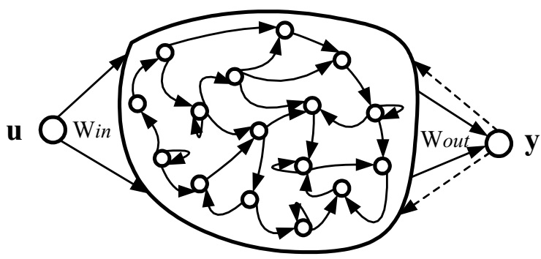
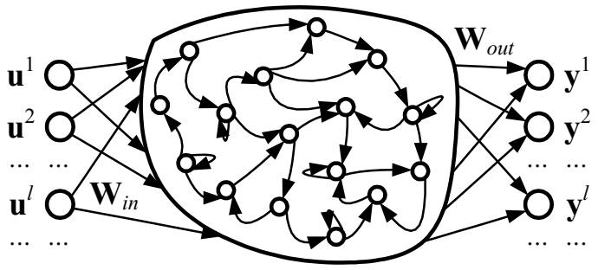
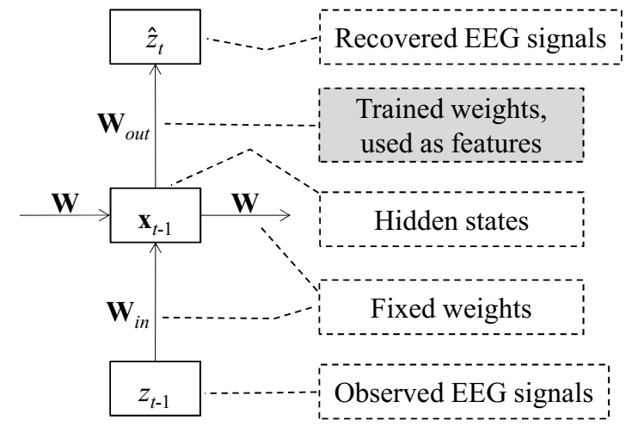
Unsupervised EEG Feature Extraction Based on Echo State Network
The key idea of the ESN is to drive a large random fixed recurrent neural network, which is called a reservoir, with the input signal, thereby inducing each neuron within the reservoir a nonlinear response signal, and then combine the desired output signal by a trainable linear combination of all of these response signals.
The core component of ESN is the reservoir network, above Figure, where input connections W_{in} (input-to-reservoir), internal connections W (neurons-to-neurons), and feedback connections W_{fb} (output-to-reservoir) are all randomly generated according to the specified parameters and fixed after being generated.
Through the training process, only the output connections W_{out} are modified.

Slide 39
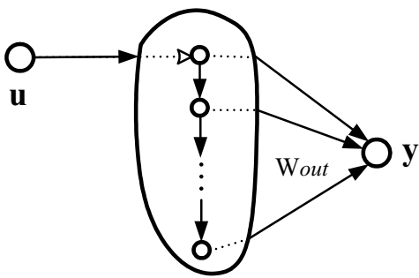
Unsupervised EEG Feature Extraction Based on Echo State Network
The effectiveness of autoregressive (AR) coefficients in EEG signal classification has been reported. Though both ESN and AR models can be used in time series prediction, the relationship of the ESN with the AR model has not been discussed ever before. Here, the effectiveness of AR coefficients to present EEG signals in both metrics of classification accuracy and versatility will be investigated. The classical AR model with order p can be written as
$$z_{t}=a_{1}z_{t−1}+a_{2}z_{t−2}+…+a_{p}z_{t−p}+ε_{t}$$
$$W_{in}=\left[\begin{matrix}1 \\ 0 \\ 0 \\ 0 \\ ⋮ \\ 0\end{matrix}\right], W=\left[\begin{matrix}0 & 0 & 0 & ⋯ & 0 & 0 \\ 1 & 0 & 0 & ⋯ & 0 & 0 \\ 0 & 1 & 0 & ⋯ & 0 & 0 \\ 0 & 0 & 1 & ⋯ & 0 & 0 \\ ⋮ & ⋮ & ⋮ & ⋱ & ⋮ & ⋮ \\ 0 & 0 & 0 & ⋯ & 1 & 0\end{matrix}\right], W_{fb}=\left[\begin{matrix}0 \\ 0 \\ 0 \\ 0 \\ ⋮ \\ 0\end{matrix}\right]$$
$$→W_{out}=\left[a_{1} a_{2}…a_{p}\right]$$

Slide 40
Unsupervised EEG Feature Extraction Based on Echo State Network
This comparison shows that feature extraction based on the autoregression model (FEAR) is in fact an autoencoder-based EEG feature extraction method, which may be one of the reasons for FEAR’s superiority over other EEG feature extraction methods.
But there is a debate that how effective a linear regression model such as AR can capture the nonlinear dynamics in EEG signals.
The advantages of the proposed FE-ESN over other methods such as FEAR are as follows:
The information lost in the feature extraction process is limited. Since FE-ESN is designed based on an autoencoder, the original signal can be approximately reconstructed with the produced feature sets.
The FE-ESN is unsupervised. It helps to use this method in most EEG analysis applications.
The FE-ESN is expected to be able to model nonlinear dynamics of EEG.
Training and decoding of FE-ESN are simple and efficient. The time and space complexity of FE-ESN depends on finding the pseudo-inverse of N×N matrix, where N is the number of neurons.

Slide 41
Unsupervised EEG Feature Extraction Based on Echo State Network
Three parameters are required to be specified in FE-ESN:
reservoir size N: the number of internal neurons and the dimension of feature space.
A small N results in underfitting, in which the ESN cannot well capture the underlying dynamics of EEG signals, and a large N may result in overfitting
Here N = 20.
connectivity c
Here $c=0.1, 0.2, …, 1.0$
spectral radius r:
It is recommended to choose a spectral radius less than unity.
Here it is chosen as r=0.98.
Extreme learning machine (ELM) is used as the classifier; because its generalization performance and learning speed have been proven to be acceptable with the least human intervention.
The ELM trained 20 times and the mean accuracy of classifiers assumed as final accuracy to decrease the impact of randomness.
Finally, 9×20×10×20 classification results were produced via 10-fold cross-validation. By taking the mean of the accuracy of 20 classifiers, 9×20×10 results are achieved.

Slide 42
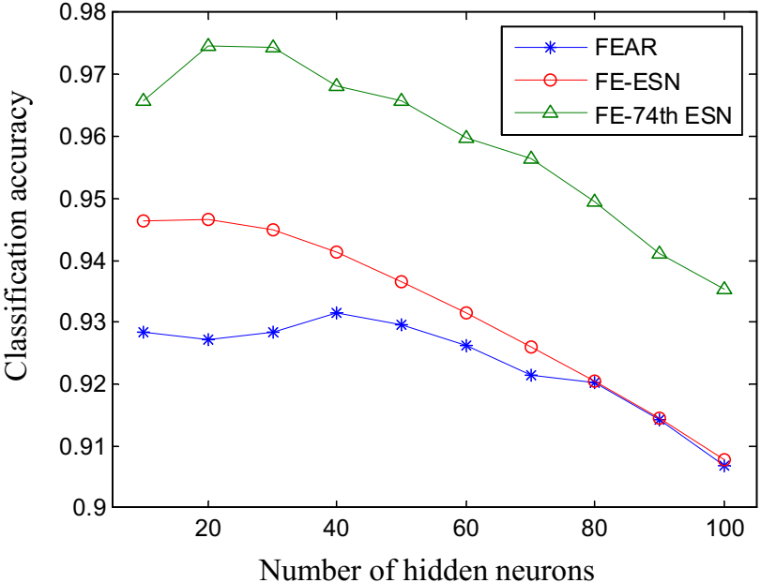
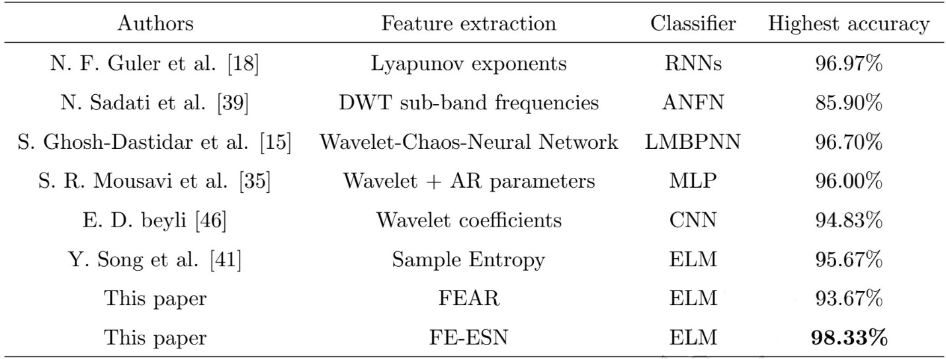
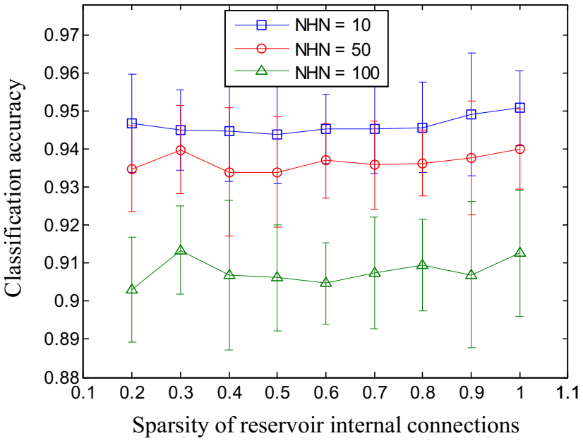
Unsupervised EEG Feature Extraction Based on Echo State Network
It can be seen that as long as the connectivity c is large enough (larger than 0.1), the difference in accuracy caused by the reservoir’s connectivity c is very limited (less than 1.0%). Also, the variance of accuracy due to randomness is approximately 2.0%.
The overall accuracy is almost 93% which indicates FE-ESN + ELM EEG signal classification system is robust against the reservoir’s internal connectivity and its randomness.

Slide 43
Unsupervised EEG Feature Extraction Based on Echo State Network
EEG signals in the Kaggle dataset are labeled for four stages: interictal (between seizures), preictal (before seizure), ictal (seizure), and post-ictal (after seizure).
The FEAR, DWT, FFT, and LyExp have been used as EEG feature extraction baselines.
The wavelet coefficients in DWT were computed by Daubechies wavelet of order two.
SVM is used as the classifier.
Kaggle Experiment Result ROC-AUC
Kaggle Experiment Result PR-AUC

Slide 44
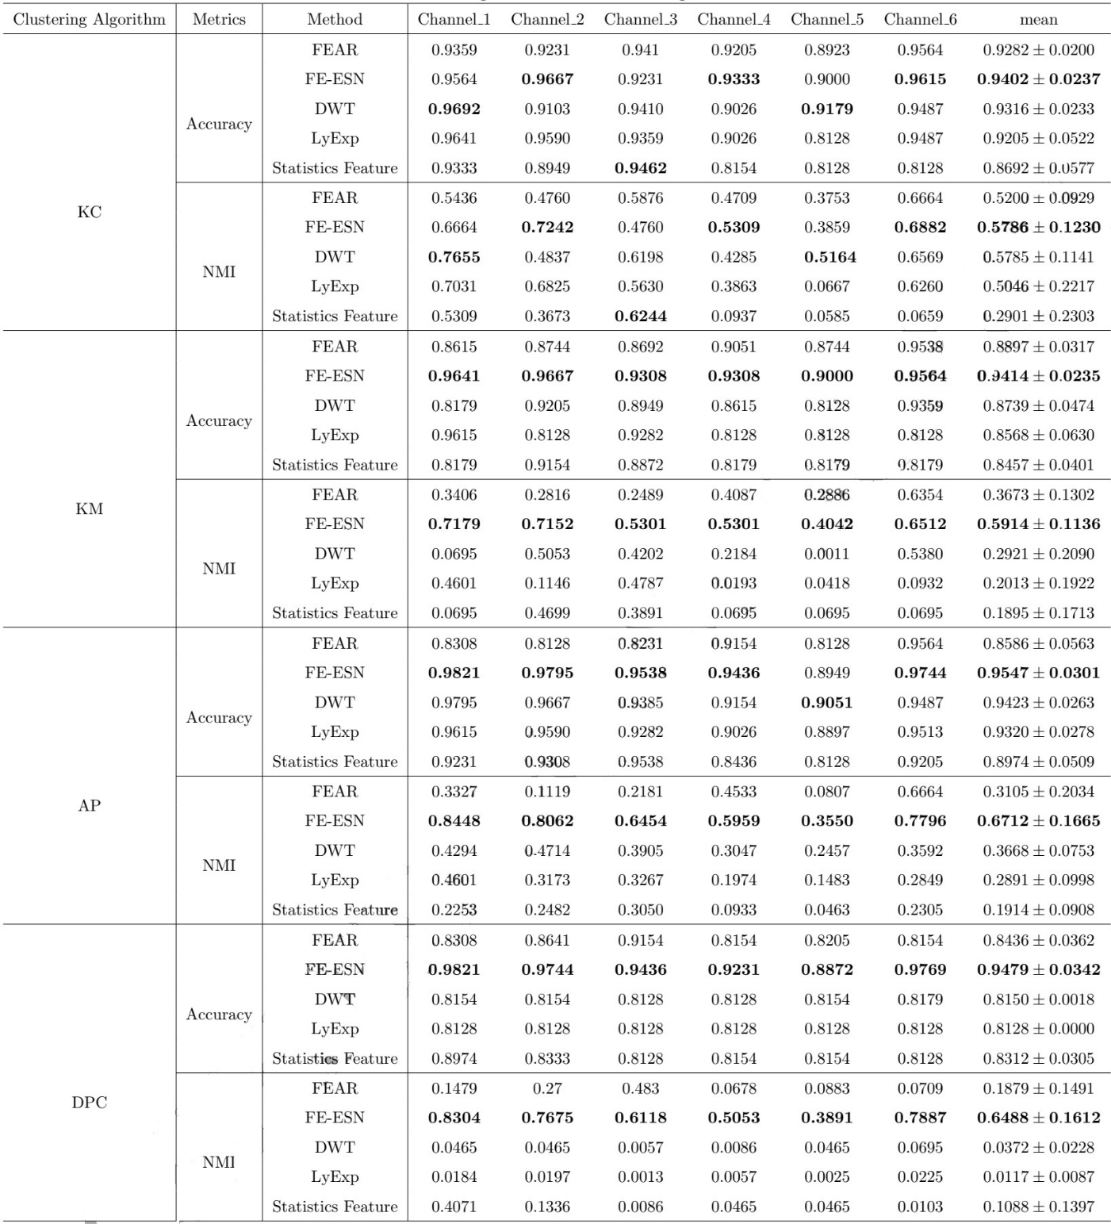
Unsupervised EEG Feature Extraction Based on Echo State Network
The better results of both FEAR and FE-ESN on Channel_1, Channel_2, and Channel_6 compared to Channel_3, Channel_4, and Channel 5 indicate that the first channel set has a more clear ictal lesion.
Result shows that FE-ESN is significantly better than other algorithms using KM, AP, and DPC clustering methods. The average performance of FE-ESN on all six channels is higher than other methods using KC, however, it is not significant.

Slide 45
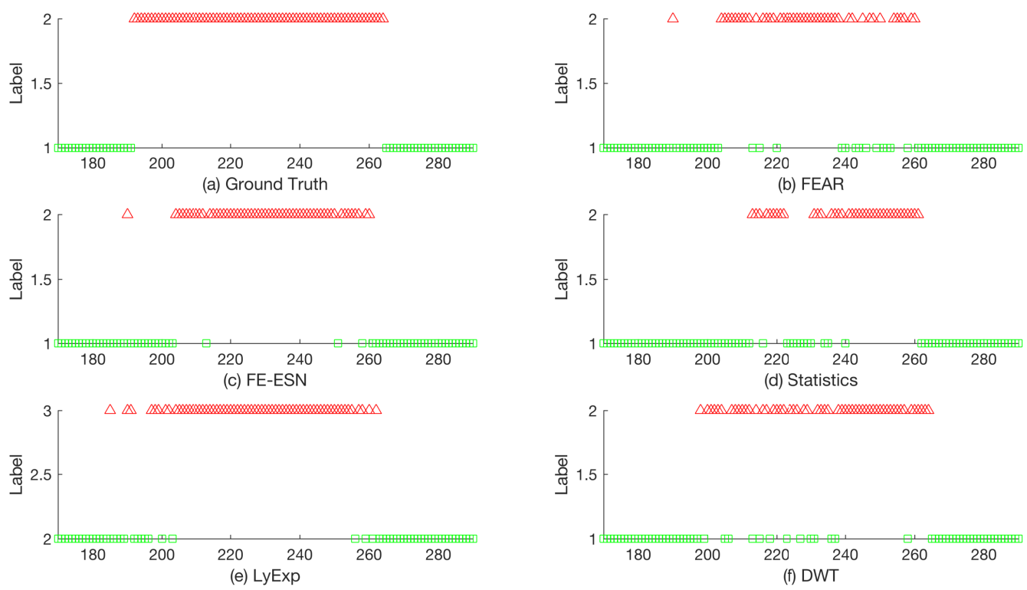
Unsupervised EEG Feature Extraction Based on Echo State Network
Single Channel
As it can be seen, no method can detect the seizure event through all its duration and every method has some gaps. Overall, FE-ESN detects most ictal EEG clips correctly, whereas the other methods missed more ictal EEG signals.

Slide 46
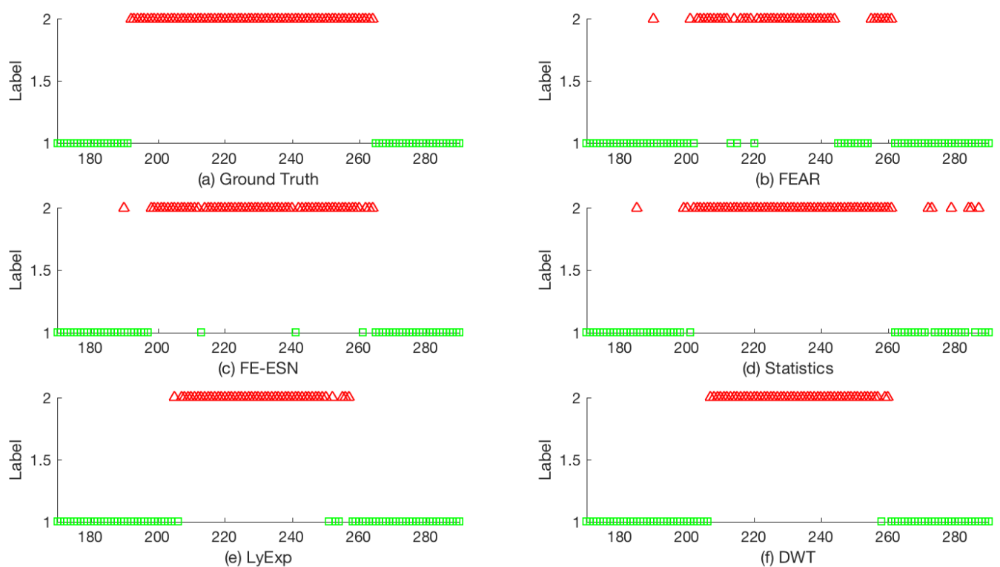
Unsupervised EEG Feature Extraction Based on Echo State Network
Multichannel
As it can be seen, the FE-ESN is very close to the ground-truth partition and it only misses a few ictal EEG clips. Other methods cannot detect the beginning and end of the seizure. FEAR missed many ictal EEG signals during the seizure, and the Statistics method had many wrong divisions at the end of the EEG signals.

Slide 47
Conclusion
In this literature review, we have reviewed the main topics in time series classification and clustering based on deep learning methods.
We reviewed several deep learning architectures for classification tasks. The result in the classification section shows that ResNet can achieve as good results as state-of-the-art ensemble methods with much less computational complexity.
Unsupervised clustering with deep learning methods was discussed. We saw that a combination of CNN, K-MEANS and data augmentation can result in a powerful unsupervised classifier.
Finally, Echo State Networks, a type of RNN, were used to extract features from input signals with reconstruction capabilities. The efficiency of extracted features compared with the top engineered feature extraction methods based on the classification accuracy metric and the overall superiority of deep learning echo state autoencoder was observed.

Slide 48
Additional References
Bagnall, A., Dau, H. A., Lines, J., Flynn, M., Large, J., Bostrom, A., Southam, P., & Keogh, E. (2018). The UEA multivariate time series classification archive, 2018. 1–36. http://arxiv.org/abs/1811.00075.
Baydogan, M. G. (2015). Multivariate time series classification datasets. http://www.mustafabaydogan.com/
Chang, S., Zhang, Y., Han, W., Yu, M., Guo, X., Tan, W., Cui, X., Witbrock, M., Hasegawa-Johnson, M., & Huang, T. S. (2017). Dilated recurrent neural networks. Advances in Neural Information Processing Systems, 2017-Decem(Nips), 77–87. https://arxiv.org/abs/1710.02224.
Dau, H. A., Bagnall, A., Kamgar, K., Yeh, C. C. M., Zhu, Y., Gharghabi, S., Ratanamahatana, C. A., & Keogh, E. (2019). The UCR time series archive. IEEE/CAA Journal of Automatica Sinica, 6(6), 1293–1305. https://doi.org/10.1109/JAS.2019.1911747.
Han, M., & Sun, L. (2010). EEG signal classification for epilepsy diagnosis based on AR model and RVM. 2010 International Conference on Intelligent Control and Information Processing, 134–139. https://doi.org/10.1109/ICICIP.2010.5565239.
He, K., Zhang, X., Ren, S., & Sun, J. (2016). Deep residual learning for image recognition. Proceedings of the IEEE Computer Society Conference on Computer Vision and Pattern Recognition, 2016-Decem, 770–778. https://doi.org/10.1109/CVPR.2016.90.
Jaeger, H., & Haas, H. (2004). Harnessing Nonlinearity: Predicting Chaotic Systems and Saving Energy in Wireless Communication. Science, 304(5667), 78–80. https://doi.org/10.1126/science.1091277.
Lines, J., Taylor, S., & Bagnall, A. (2017). HIVE-COTE: The hierarchical vote collective of transformation-based ensembles for time series classification. Proceedings - IEEE International Conference on Data Mining, ICDM, 1041–1046. https://doi.org/10.1109/ICDM.2016.74.
Wang, L., Xue, W., Li, Y., Luo, M., Huang, J., Cui, W., & Huang, C. (2017). Automatic epileptic seizure detection in EEG signals using multi-domain feature extraction and nonlinear analysis. Entropy, 19(6), 1–17. https://doi.org/10.3390/e19060222.

Slide 49
Questions

Slide 50
Thank You

