Slide 1
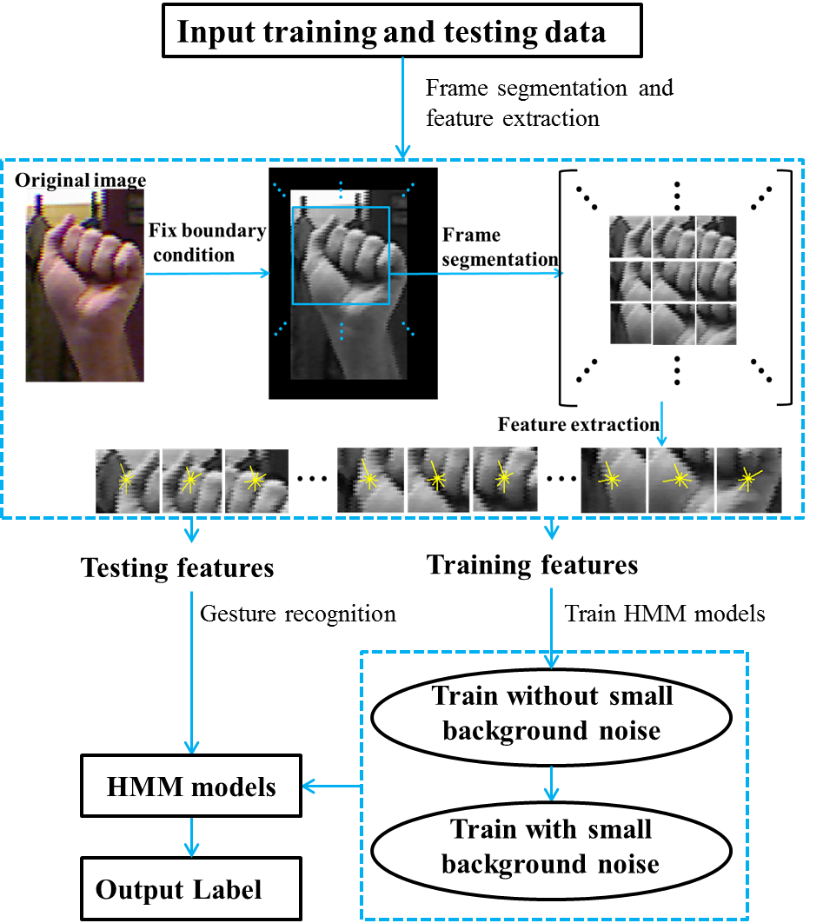
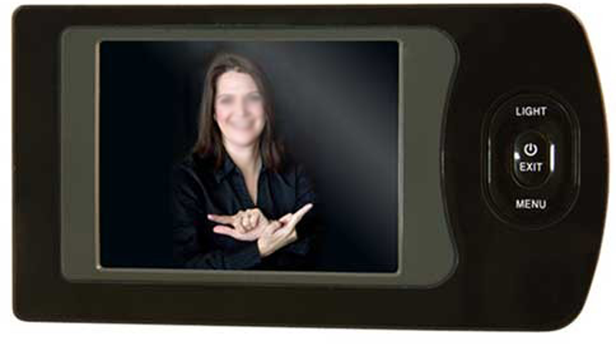
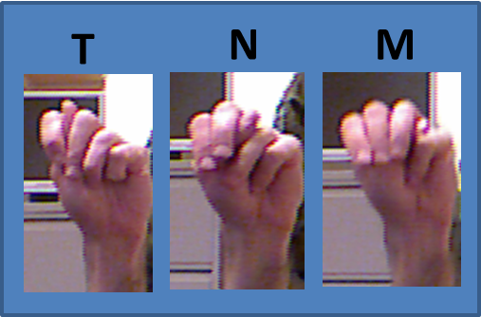
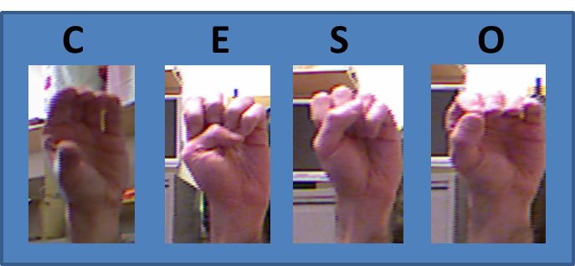
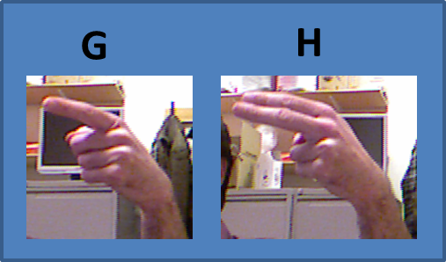
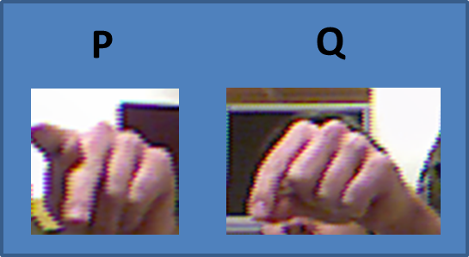
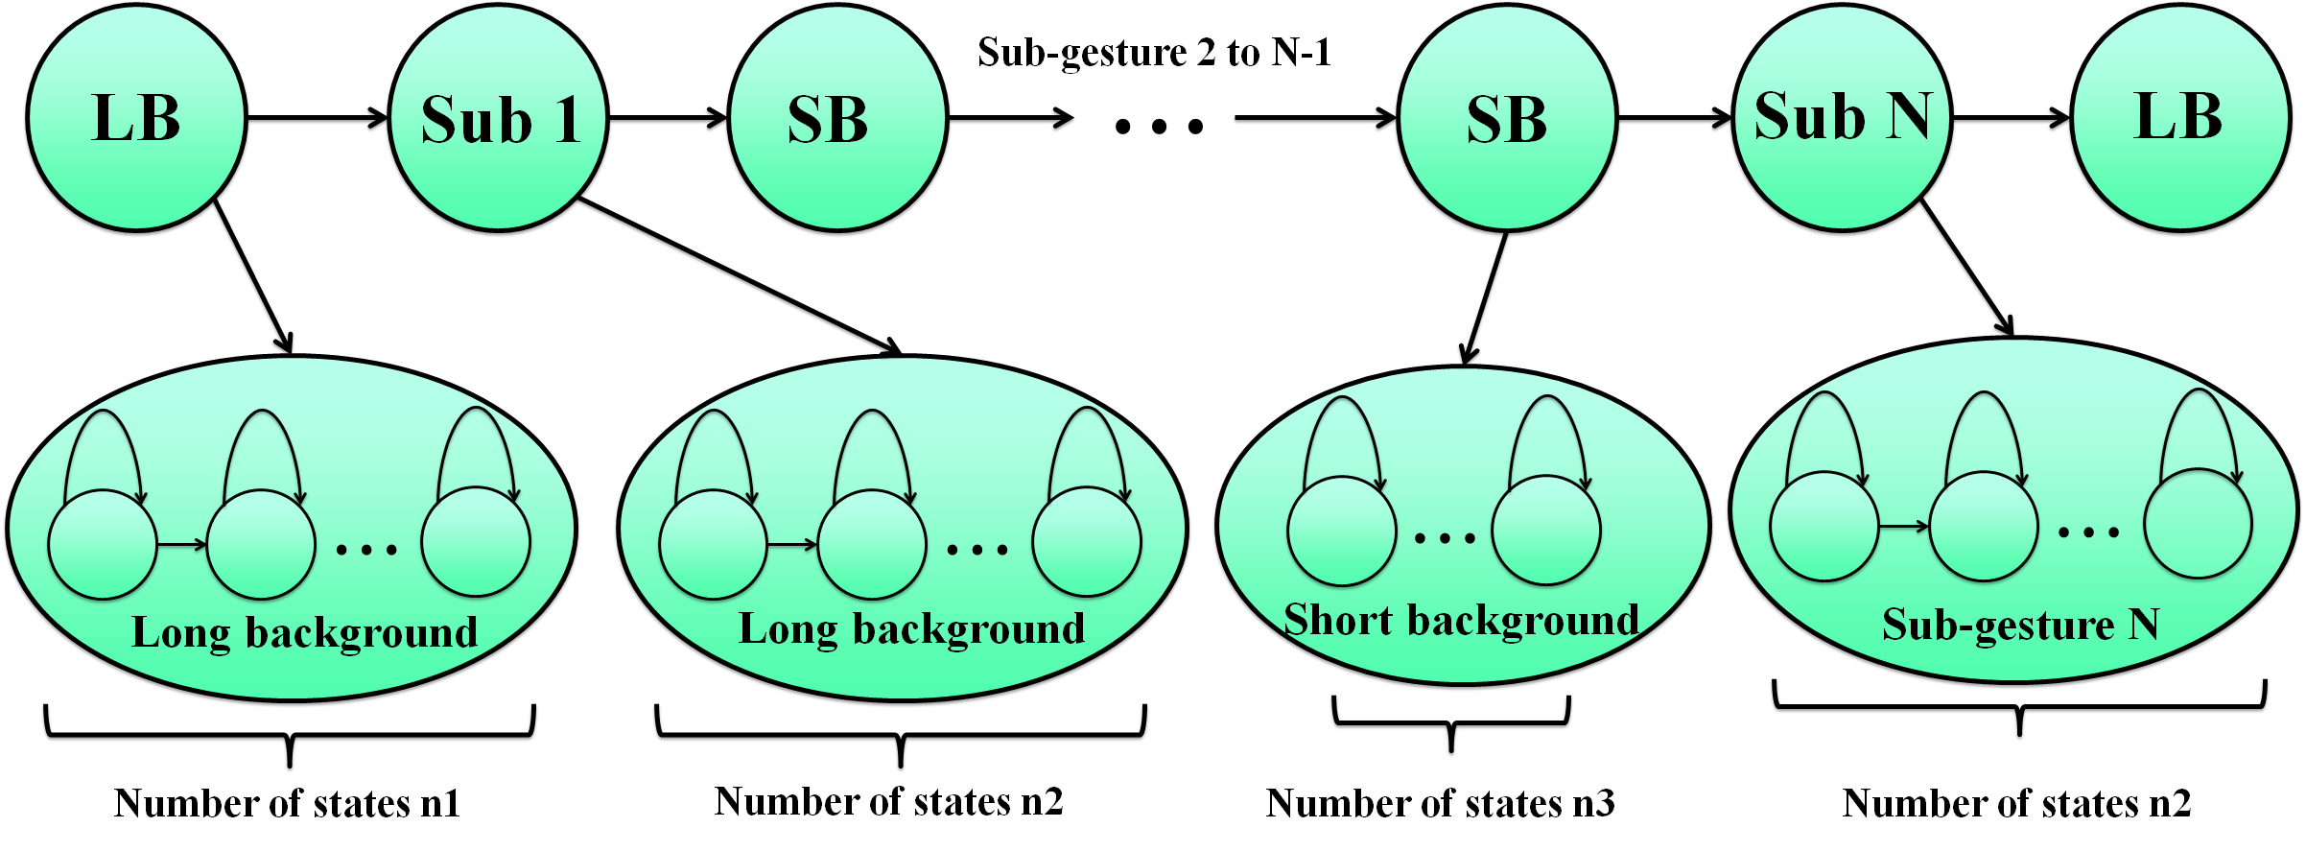
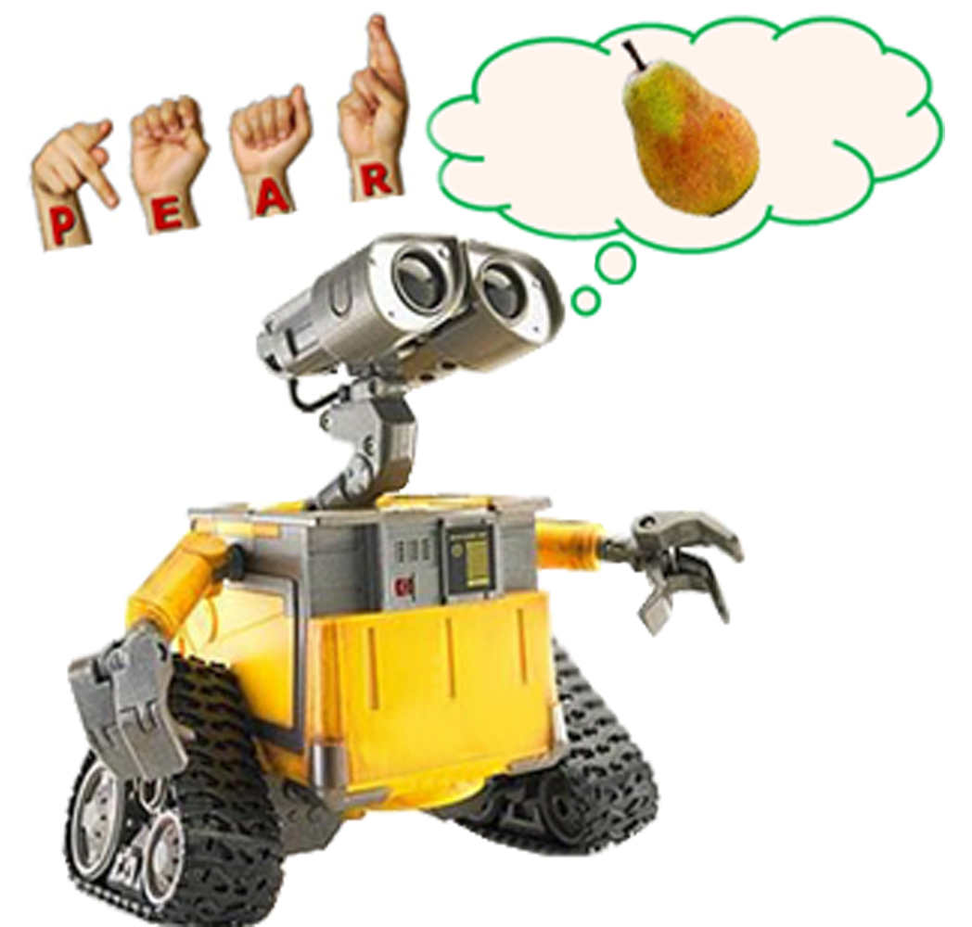
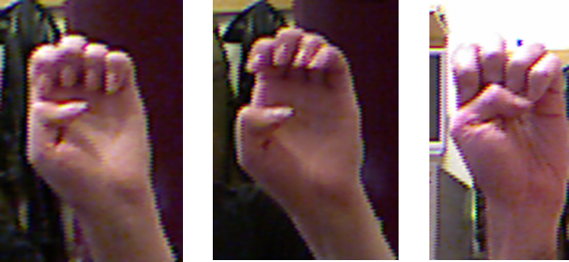
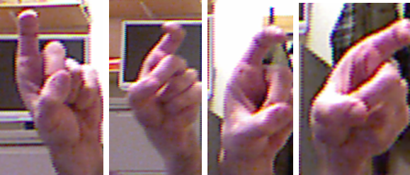
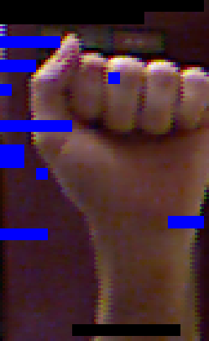
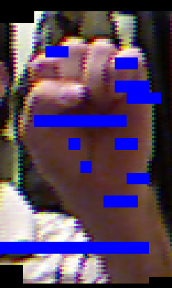
College of Engineering
Temple University
Fingerspelling Recognition Using Sub-gesture Hidden Markov Models
www.isip.piconepress.com
Shuang Lu and Dr. Joseph Picone Department of Electrical and Computer Engineering, Temple University
Abstract
Fingerspelling is widely used for education and communication among signers. We propose a new static fingerspelling recognition framework based on a left to right Hidden Markov model (HMM):
An overlapping frame-based analysis is used to generate features;
Histogram of Oriented Gradient (HOG) features are extracted.
Sub-gesture models are used that allow for precise modeling of background noise.
Three design issues were investigated:
the number of sub-gestures;
the number of states in the HMMs;
signer-dependent (SD) and signer-independent (SI) training.
Our best singer-independent (open-loop) system achieves an error rate of 21.9% on the ASL Finger Spelling Dataset which represents the best published results on this data.
Recognition Architecture
Experimental Results
ASL Fingerspelling Dataset:
5 signers
24 fingerspelling gestures corresponding to 26 English letters except for j and z
over 500 tokens per gesture
variations in backgrounds
SI: train on 4 signers, test on 1
SD: randomly divide data into 10 subsets, train on 9 and test on 1.
Best system configuration:
No. of sub-gestures: 11
HMM order for sub-gestures: 13
Long background order: 11
Short background order: 1
Frame and window size: 5 / 30
No. of HOG feature bins: 9
No. Gaussian Mixtures: 16
Training Mode:
Best SD error rate: 10.9%
Best SI error rate: 52.4%
Training without short background noise
Training with short background noise
Fig. 1. Histogram of Oriented Gradient (HOG) features are segmented within each frame as input of the HMMs. Long background noise model is added at the beginning and end of each gesture.
Applications
Sub-gesture HMMs
Error Analysis
Conclusions
Sub-gesture HMMs performance of 52.4% represents best published results on the ASL Finger Spelling Dataset.
Completely automated training based only on the identity of a gesture.
Performance is most sensitive to signer variations and similarities between signs, and least sensitive to variations in the background.
The architecture can be extended to continuous sign language recognition.
Future Work
The short background model needs more investigation since it is crucial to segmentation performance.
Better features and an improved syntactic structure are required to decrease confusion between similar gestures.
Sub-gesture HMM Topology
Model parameters
Left-Right models
Grammar: LB -> gesture-> LB
(LB: long background )
Similarities between gestures:
Variations in signers:
Segmentation:
Education
Entertainment
Communication
Robotic control
Human computer interaction
Benefits:
Baum Welch algorithm
The algorithm segment background noise and each sub-gesture automatically
Robust to variations in background
Good
Bad
Notes:
This poster template is from http://www.swarthmore.edu/NatSci/cpurrin1/posteradvice.htm. It is free, free, free for non-commercial use. But if you really like it, I’m always thrilled to get postcards from wherever you happen to be presenting your poster. Or, send me cookies! My kids made me put that last sentence in. Have fun. Sincerely, Colin Purrington, Department of Biology, Swarthmore College, Swarthmore, PA 19081, USA. Email: cpurrin1@swarthmore.edu

