Slide 1
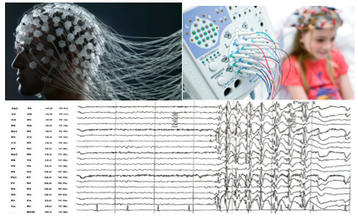
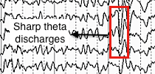
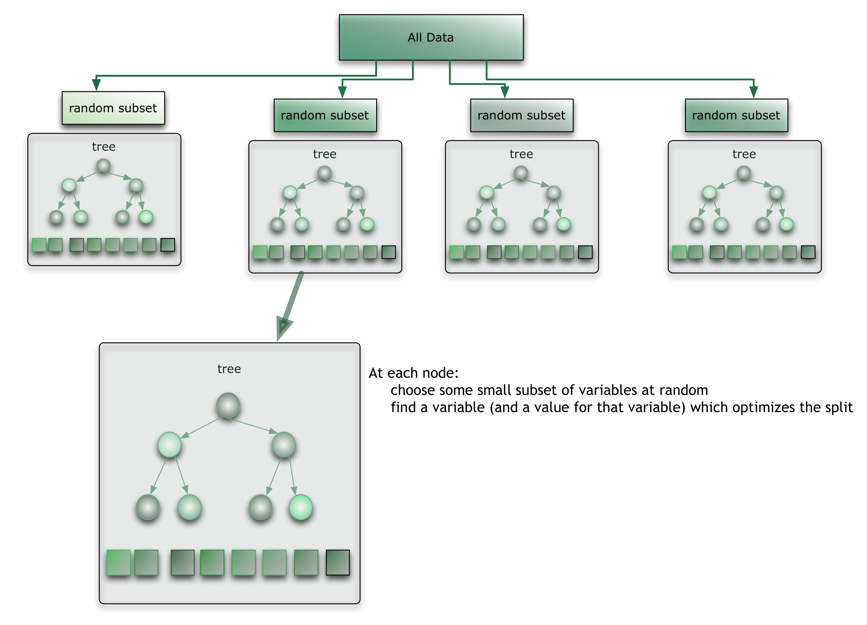
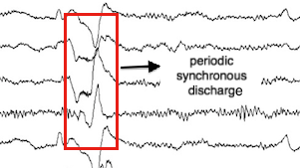
A MACHINE LEARNING APPROACH TO AUTOMATED IDENTIFICATION OF ABNORMAL EEGS
G. Suarez, J. Soares, S. Lopez, I. Obeid and J. Picone
The Neural Engineering Data Consortium, Temple University
College of Engineering
Temple University
www.isip.piconepress.com
Abstract
The TUH EEG Corpus is the largest and most comprehensive publicly-released corpus representing 11 years of clinical data collected at Temple Hospital. It includes over 15,000 patients, 28,000+ sessions, 50,000+ EEGs and deidentified clinical information.
About 75% of the EEGs contained in the TUH EEG Corpus have been identified as abnormal, allowing for a large pool of data that can be used to analyze the underlying factors predicting abnormalities.
The goal of this work is to augment our system that automatically interprets EEGs, known as AutoEEGTM, with abnormal EEG classification.
A simple machine learning approach based on random forests and principal components analysis resulted in a 40.3% classification error rate.
Random guessing based on priors resulted in a 49.8% error rate.
Machine Learning
Though machine learning has been to classify EEG signals, prior results have yet to be sufficiently successful.
Yuan et al. (2012) used a wavelet transform and the extreme learning machine algorithm to classify interictal and ictal EEGs, achieving an accuracy of 99.25% on the Bonn EEG data.
Cao et al. (2008) used the support vector machines to identify residual functional abnormalities in athletes suffering from concussions, producing 77.1% accuracy on a corpus of 61 athletes at risk.
Karlik & Hayta (2014) used artificial neural networks to identify epileptic seizures with 99.75% accuracy on a corpus of 200 normal/abnormal EEGs.
Hussain et al. (2015) used a combination of algorithms including k-nearest neighbors to achieve a 98.22% accuracy on the detection of alcoholism using EEGs.
Corpus Statistics
The first step in this process was collecting data from the TUH EEG Corpus:
Results
A random forest algorithm was used to train a two-way classifier, and provided results that were more accurate than guessing based on priors.
A PCA dimension of 20 was used in this experiment.
The initial vector dimension was 27x600, representing the first 60 secs of the signal. This was done to simulate the amount of data used by neurologists in making this decision.
Year | # Normal | # Abnormal | Total
2003 | 17 | 18 | 35
2004 | 23 | 25 | 48
2005 | 4 | 7 | 11
2006 | 31 | 18 | 49
2007 | 18 | 15 | 33
2008 | 14 | 20 | 34
2009 | 14 | 25 | 39
2010 | 15 | 13 | 28
2011 | 16 | 24 | 40
2012 | 26 | 20 | 46
2013 | 24 | 15 | 39
Total: | 202 | 200 | 402
Figure 8. A comparison of random forests to guessing based on priors.
Figure 4. An Analysis of the Data By Year of Collection
Introduction
Electroencephalography (EEG) is increasingly being used for preventive diagnostic procedures.
Abnormalities in EEG signals can be caused by a wide range of reasons; however, much can be identified by observing the posterior dominant rhythm and vulnerable temporal lobes.
Events such as spikes, sharp waves and epileptic patterns usually indicate abnormal behavior.
Context plays an important role in determining whether these events are associated with an abnormality:
Methodology
Manually selected 139 normal and 119 abnormal .edf files and used features derived from one channel of the signal.
Channel T5-O1 from a TCP montage was selected because it contains information about the posterior dominant rhythm.
A standard 9-element feature vector (8 cepstral features plus a special differential energy term) were augmented with first and second derivatives, giving a 27‑dimension feature vector.
A concatenated feature vector was built from the first 60 secs of the signal, giving a supervector of dimension 27 x 600.
Principal components analysis was used to reduce the dimension to approximately 20 features.
A “leave-one-out” cross-validation approach was used to assess performance.
A random forest approach was used to classify the data (based on TreeBagger in MATLAB):
Figure 5. An EEG of an epileptic patient. The intensity of the spike and waves are an indication of epilepsy.
Input:
EEG raw data
Figure 9. Error Rate as a Function of PCA Dimension
Figure 6. An EEG of a patient diagnosed with a concussion. Frequent paroxysmal sharply contoured theta discharges are usually an indication of a concussion.
Summary
Abnormal behavior in EEGs can generally be detected by the posterior dominant rhythm, making the channel T5-O1 the most effective channel to examine for abnormal behavior.
The combination of random forests and principal components analysis is a promising approach. A relatively small number of dimensions can be used.
Future work will include optimizing the parameters of this system, and incorporating more sophisticated temporal modeling (e.g., hidden Markov models), and developing better criteria for building a supervector representation of the data.
Acknowledgements
Many thanks to the Honors Program in Temple University for funding my research through the Merit Scholars Summer Stipend program.
Figure 1. A Typical Abnormal EEG
EEG Signal
Standard/Normal
Nonstandard/Abnormal
Healthy
Benign Variant
Healthy
True Abnormality
Unhealthy
Figure 7. An EEG of a patient suffering from a form of measles, subacute sclerosing panencephalitis (a progressive neurological complication of measles). Periodic synchronous discharges are observed.
Figure 2. A Decision Tree to Classify Abnormal EEGs
Figure 3. The TreeBagger Approach to Random Forests

