Slide 1
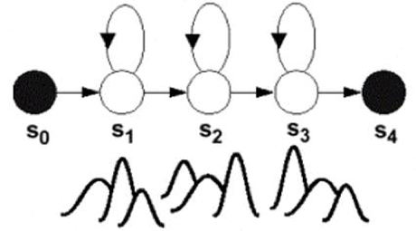
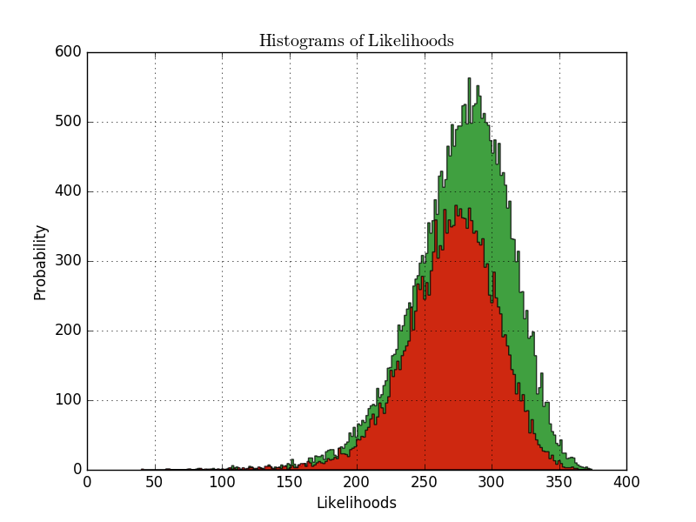
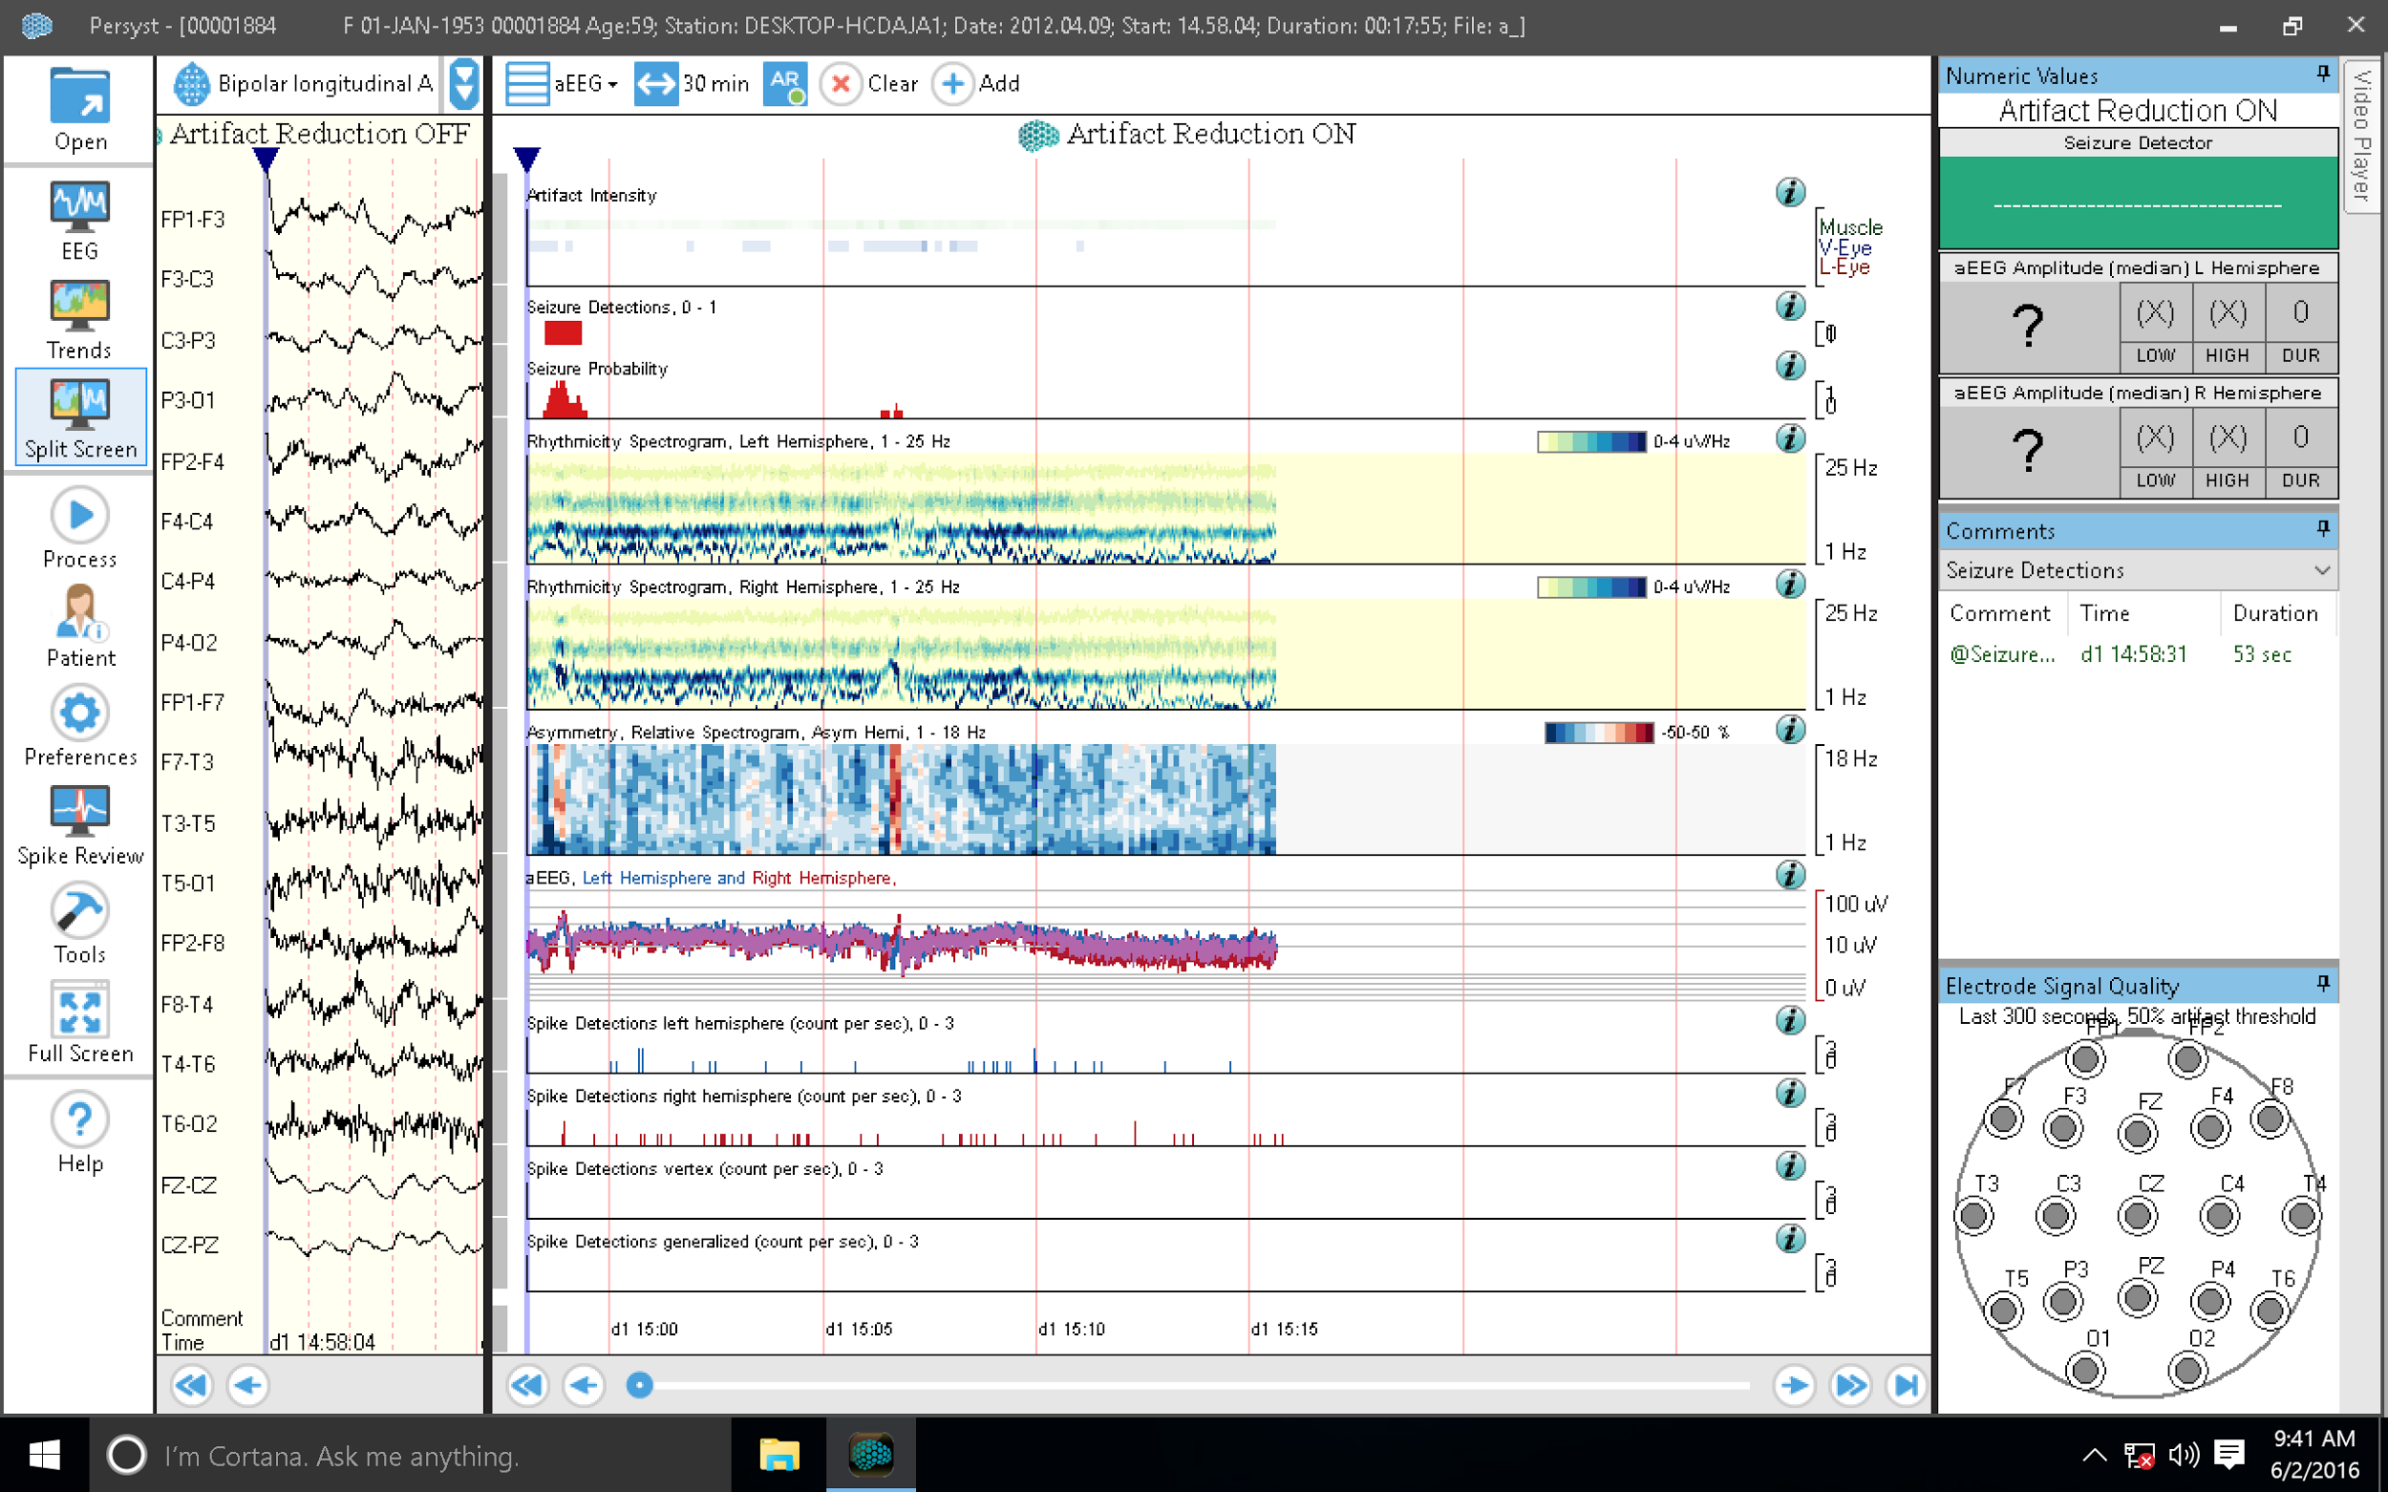
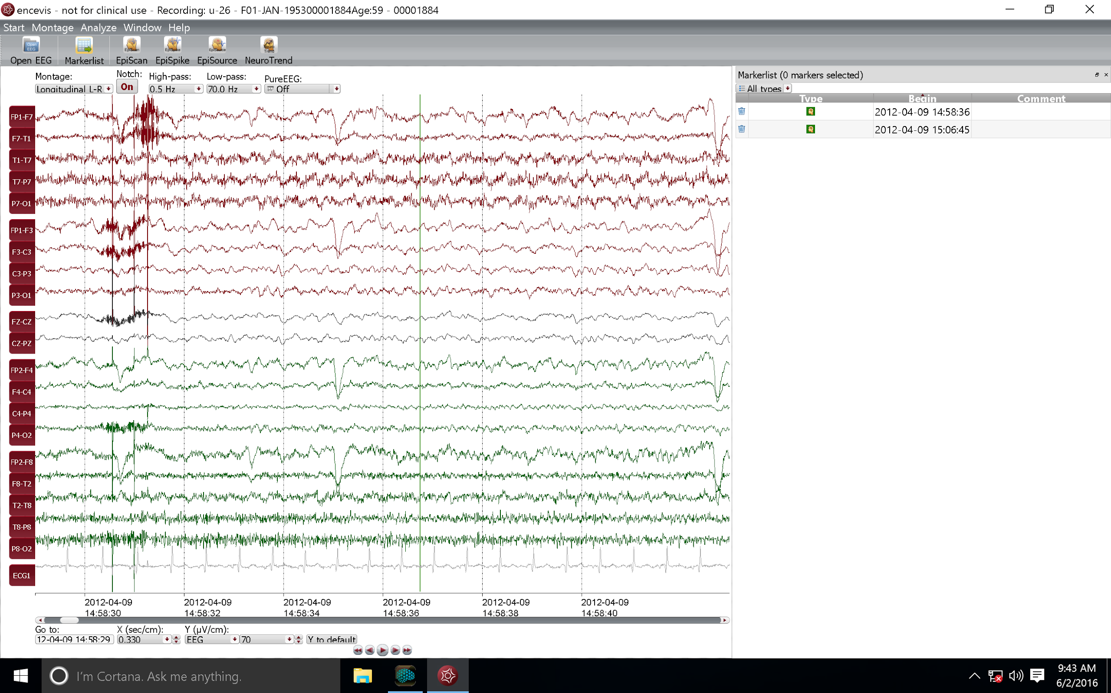
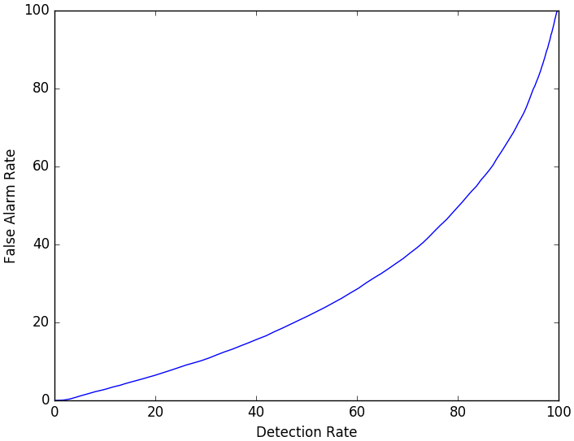
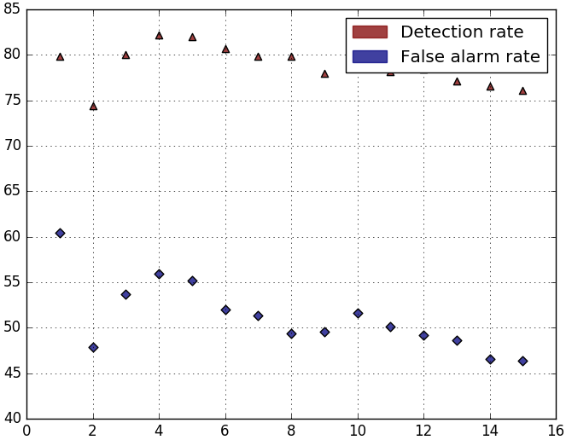
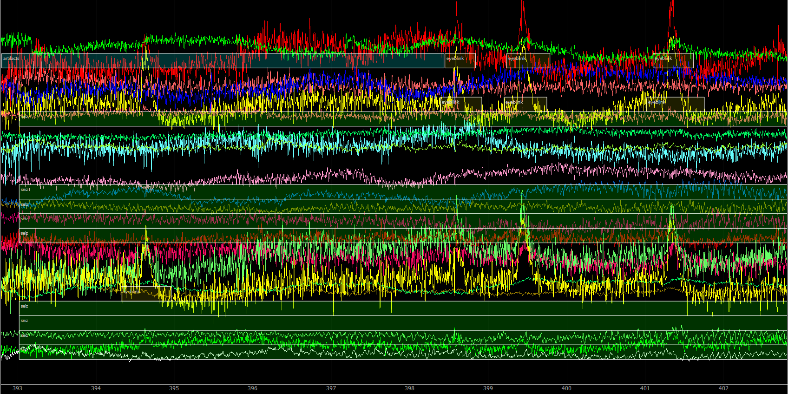
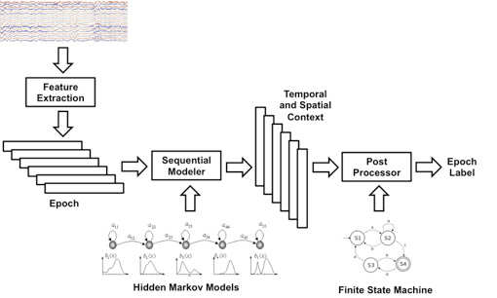
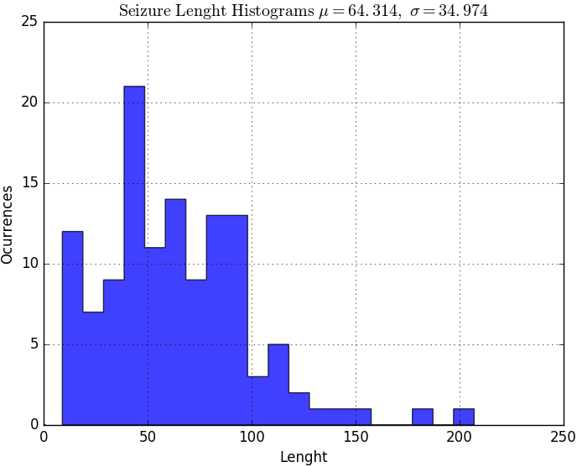
Real-time Seizure Detection Using Hidden Markov Models
M. Andrade, V. Shah, S. Lopez, M. Golmohammadi, I. Obeid and J. Picone
The Neural Engineering Data Consortium, Temple University
College of Engineering
Temple University
www.nedcdata.org
Abstract
Seizure detection using surface EEG recordings is an extremely challenging task. Real-time clinical applications demand extremely low false alarm rates (e.g., less than 1 false alarm every 8 hours).
The lack of big data resources that can be used to train sophisticated statistical models further compounds the problem. A major goal was to generate a large annotated corpus of seizure events that can support machine learning experiments.
Using the TUH EEG Corpus, the world’s largest open-source clinical EEG corpus, we implemented a semi-automated strategy to label seizures:
EEG reports were parsed to locate sessions most likely to contain seizures.
Two commercial seizure detection tools (Persyst and Encevis) were used to identify seizures.
The sessions for which these tools produced similar annotations were then manually reviewed by an expert. This resulted in 124 seizures events, which totaled 7,975 seconds in duration.
A baseline automatic interpretation system, AutoEEG, was then trained to detect seizure events, resulting in a detection rate of 79.8%, a false alarm rate of 49.4% and an overall error rate of 34.7%.
Semi-Automated Seizure Annotation
Our seizure detection model uses a supervised learning approach:
To generate classified data, the TUH EEG corpus was processed to label seizure events.
Two commercial software systems were used to identify seizure events.
Regions where both tools agreed with high confidence were manually reviewed by an expert.
Since the total background duration vastly exceeds the total seizure duration, using the entire background data would result in a biased classifier.
A good compromise between class representation and dataset size was achieved by using the same duration of seizure and background events. The background selection was performed randomly.
Experimental Design
The annotated data was divided into training and evaluation subsetsbased on seizure duration, designating 80% of the labeled seizure time to training and 20% to evaluation.
The first batch of data covers 39 recording sessions of different subjects, corresponding to the first batch of annotated data, accounting for 7,975 seconds of seizures.
Training and Evaluation
AutoEEG uses standard three-state HMMs:
Feature vectors consist of frequency domain energy (E_{f}), a differential energy term (E_{d}) and 7 cepstral coefficients. These features are similar to those successfully used in speech recognition.
These features are postprocessed to include 1st and 2nd derivatives. The 2nd derivative is discarded for E_{d}.
Diagonal covariance matrices were used for each mixture component.
The optimal number of mixture components was experimentally determined to be 8 per state:
Decoding
A maximum likelihood decoding strategy was used:
Epoch likelihood values are computed for each model. Epoch segments are processed through an extension of the HTK library, using model probabilities to obtain the final likelihood value.
To generate the resultant DET curve, classification is performed using sweep values over background class likelihoods. The range for sweep values goes from -50 to 50, having 0.5 increments and totalizing 201 elements. Classification is done once for each of the values, that are added to the background likelihood.
The sweeping process allows the system to operate in states between a completely biased seizure classifier (i.e high negative sweep values) and a completely biased background classifier (i.e high positive sweep values).
The DET curve plots the seizure false alarm by detection rate for all the sweep values used.
Results
The baseline system achieved acceptable seizure sensitivity (79.9%), although it shows a high false alarm rate (49.4%).
Detection Error Tradeoff (DET) Curve
Performance of the baseline system does not meet the requirements for real-time clinical applications. More annotated data is needed to improve classification.
Confusion matrix
Likelihood Distribution
 | SEIZ | BCKG
SEIZ | 79.9% | 20.1%
BCKG | 49.4% | 50.6%
Persyst Encevis
Figure 7: Classification performance
Figure 5: HMM signal models
Figure 2: Commercial seizure detection tools
Background
EEG’s are multichannel signals recorded using electrodes attached to the scalp.
Commercial seizure detection systems suffer from an extremely high false alarm rate, making them useless for real-time clinical applications.
Hidden Markov Model (HMM) and Deep Learning (DL) techniques which have been successful in other applications (e.g., speech recognition) were applied to identify seizure patterns in EEG’s.
AutoEEG uses HMMs to classify 1-second signal epochs as one of six events: generalized periodic epileptiform discharge (GPED), periodic lateralized epileptiform discharge (PLEDs), spike and sharp wave (SPSW), artifact (ARTF), eye movement (EYEM), and background activity (BCKG).
The goal of this research was to adapt AutoEEG to a seizure detection task. Seizures can be focal or general, but were scored based on epochs.
We developed a semi-automated annotation process so that we could generate a large amount of annotated training data (crucial for HMMs and DL).
Figure 8: A Detection Error Tradeoff (DET) curve
Figure 6: Performance vs. no. of mixture components
Summary
Achieving a low false alarm rate for real-time seizure detection in clinical applications is an extremely challenging problem.
The database under development currently has 133 seizure events that together accounts for 7,914 seconds. Annotation is an on-going process.
Our baseline system had an overall error rate of 34.8%, a seizure detection rate of 79.9% and a false alarm rate of 49.4%.
Future directions include converting HMMs to deep learning, adding spatial and temporal context to the feature extraction process, and developing more sophisticated statistical models.
Acknowledgements
This research was supported by the Brazil Scientific Mobility Program (BSMP) and the Institute of International Education (IIE).
Figure 3: An annotated EEG
Figure 1: An overview of AutoEEG
Figure 4: Seizure Events length distribution.

