Slide 1
Correct detections
False Alarms
Misses
Ictal
Reference
Non-ictal
Ictal
Detection
Non-ictal
Time
Epochs

Slide 2
Correct detection
False Alarm
Miss
Ictal
Reference
Non-ictal
Ictal
Detection
Non-ictal
Time

Slide 3
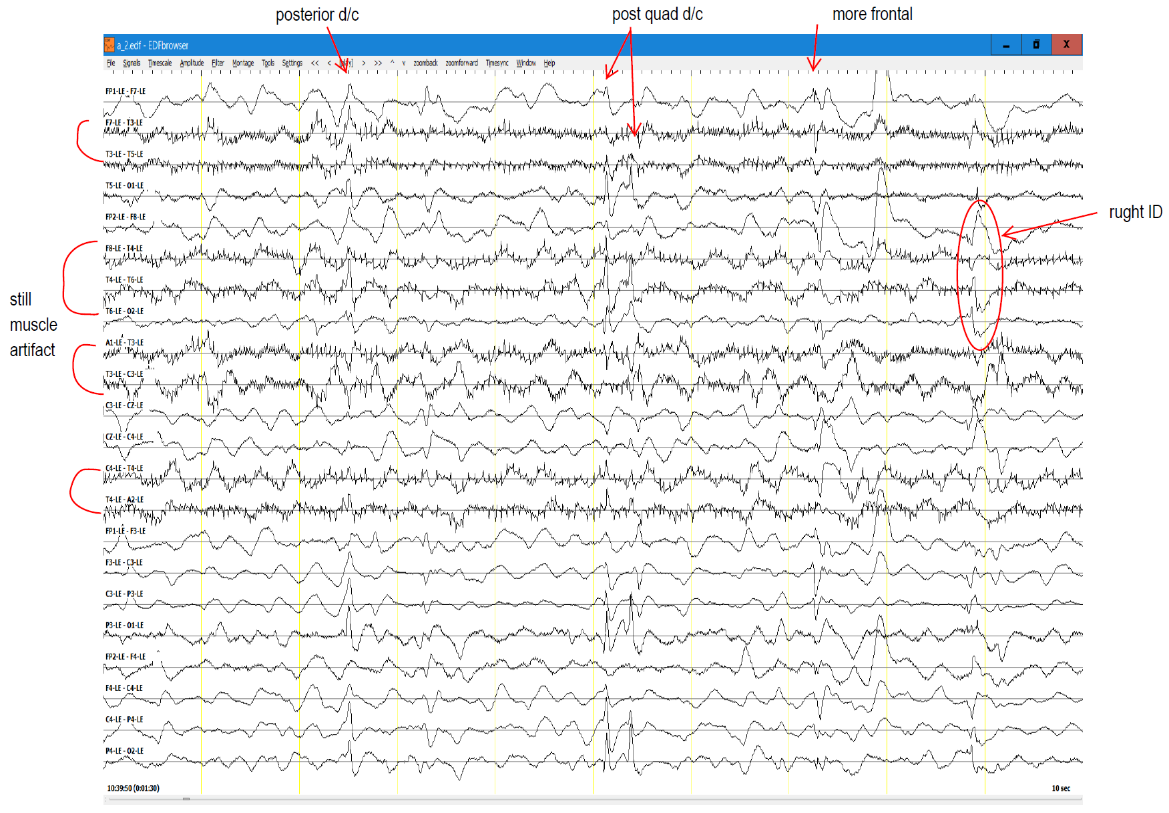

Slide 4
Seizures
Background

Slide 6
